Slide 1
Acute Exacerbation of COPD
BHUSHAN S. WANKHADE
MD (Anesthesiology), FNB (CCM), EDICM

Slide 2
Case
A 55 yr old male, reformed smoker
Admitted to our hospital; ER on 25/3/15 at 6.45pm with
Fever high gr
Cough with expectoration
Breathing difficulty
Altered mental status since 1 day
No H/O recent travel, exposure to crowd
No H/O chest pain, palpitations, limb swelling, decreased urine output
No H/O weakness in part of body
Since 3 days

Slide 3
On evaluation
Vitals stable, SpO2-95% on low flow O2
CVS-NAD
RS- B/L wheezing present
CNS- GCS-E1, M3, V1(5/15)
ABG(at 7.07PM) 7.13/108.7/82/24.3
So he was treated with bronchodilators, BiPAP support
All routine investigations, X-ray chest, ECG, blood culture, CUE

Slide 5
ECG-RAD
2DECHO- RA/RV dilated, PAH, RVSP-40, good LV function, NO RWMA
At 8.30 pm GCS further dropped to 3/15, patients stops breathing, so intubated
Developed shock; so started on vasopressors and shifted to MICU for further management
I/V/O shock, Invasive lines inserted
Patient was kept on AC-PCV
Antibiotics ceftriazone+Levoflox started
Steroid methyl pred 40 mg once a day started

Slide 7
Patients was fluid resuscitated, sedated with DEXEM
Investigations
 | 25/3/15 | 27/3/15
Hb | 13.4
TLC/plt | 9.6/175
Creat | 1.28 | 0.7
Na+/K+/Cl- | 132/4.6/92 | 138/4.7/98
LFT | NAD
SGOT | 99
SGPT | 111

Slide 8
0n 26th morning patient was haemodynamically stable, good urine output
ABG
Sedation stopped, neurologically-good
spontaneous breathing trial was given
Time | PH | PaCO2 | PaO2 | HCO3
25/3, 8.37 pm | 7.12 | 109.7 | 88 | 34.1
26/3, 5.05 am | 7.47 | 43.8 | 114 | 31.5

Slide 9
But patient was not breathing at all
So again ventilated with AC-VCV with low rate
Ammonia -44
ABG (3.05 pm) 7.39/55.3/95/32.7
Started breathing in evening, given PSV trial
Over night kept on full support
Extubated next day morning
Blood cultures-sterile, CUE-NAD, ET secretion- occasional GNB

Slide 10
Post extubation given intermittent NIV
Post extubation ABG-7.43/56/65/36.1
Shifted to HDU in evening
Discharged in stable condition on 28/3/15

Slide 11
Diagnosis
COPD, exacerbation( viral), Type-2 respiratory failure
History
X ray
ABG
2DECHO
Response to management

Slide 12
www.goldcopd.org.

Slide 13
Chronic Obstructive Pulmonary Disease (COPD), a common preventable and treatable disease, is characterized by persistent airflow limitation that is usually progressive and associated with an enhanced chronic inflammatory response in the airways and the lung to noxious particles or gases.
Exacerbations and comorbidities contribute to the overall severity in individual patients

Slide 14
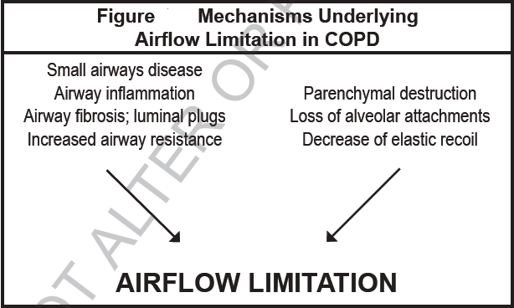
COPD is a leading cause of morbidity and mortality worldwide and results in an economic and social burden that is both substantial and increasing
Indian data#; The prevalence of COPD in India 3.67% (4.46 and 2.86% among males and females, respectively). The estimated burden of COPD in India is about 15 million cases (males and females contributing to 9.02 and 5.75 million, respectively).
#INSEARCH II

Slide 18
exacerbation of COPD
An exacerbation of COPD is an acute event characterized by a worsening of the patient’s respiratory symptoms that is beyond normal day-to-day variations and leads to a change in medication

Slide 19
Impact
In-hospital mortality of patients admitted for a hypercapnic exacerbation with acidosis is approximately 10%
Mortality reaches 40% at 1 year after discharge in those needing mechanical support
All-cause mortality 3 years after hospitalization is as high as 49%
Prevention, early detection, and prompt treatment of exacerbations are vital to reduce the burden of COPD

Slide 20
Cause of exacerbation
Respiratory tract infections (viral or bacterial).
Air pollution
About one-third of patients cause is unknown

Slide 21
DD
Pneumonia,
Pulmonary embolism,
Congestive heart failure,
Cardiac arrhythmia,
Pneumothorax,
Pleural effusion

Slide 22
ASSESSMENT

Slide 23
Investigation
Pulse oximetry/ arterial blood gases
Chest radiographs
ECG
Complete blood count
Biochemistry
Blood/sputum culture
Spirometry is not recommended

Slide 24
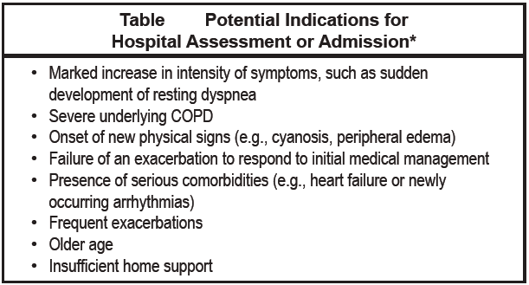
Management
Treatment Setting; outpatient or inpatient setting
More than 80% of exacerbations can be managed on an outpatient basis

Slide 25
Indication of icu admission
Severe dyspnea that responds inadequately to initial emergency therapy
Changes in mental status (confusion, lethargy, coma)
Persistent or worsening hypoxemia (PaO2 < 5.3 kPa, 40 mmHg)
Severe/worsening respiratory acidosis (pH < 7.25) despite supplemental oxygen and noninvasive ventilation
Need for invasive mechanical ventilation
Hemodynamic instability—need for vasopressors

Slide 26
Pharmacologic Treatment
Bronchodilators
Short-acting Bronchodilators. Although there are no controlled trials, short-acting inhaled beta2- agonists with or without short-acting anticholinergics are usually the preferred bronchodilators for treatment of an exacerbation (Evidence C).
No evidence for long acting bronchodilators
No evidence for inhaled steroids

Slide 27
No significant differences in FEV1 between metered-dose inhalers (with or without a spacer device) and nebulizers
Intravenous methylxanthines (theophylline or aminophylline) are considered second-line therapy, only to be used in selected cases when there is insufficient response to short-acting bronchodilators(Evidence B).
Drugs and doses

Slide 28
Corticosteroids
systemic corticosteroids in COPD exacerbations shorten recovery time, improve lung function (FEV1) and arterial hypoxemia (PaO2)(Evidence A)
Reduce the risk of early relapse, treatment failure, and length of hospital stay.
A dose of 40 mg prednisone per day for 5 days is recommended (Evidence B)
1mg prednisone=1mg methylprednisone=5mg hydrocortisone

Slide 29
Antibiotics
Antibiotics should be given to patients with exacerbations of COPD who have three cardinal symptoms – increase in dyspnea, sputum volume, and sputum purulence (Evidence B)
Have two of the cardinal symptoms, if increased purulence of sputum is one of the two symptoms (Evidence C)
Require mechanical ventilation (invasive or noninvasive) (Evidence B)
The recommended length of antibiotic therapy is usually 5-10 days (Evidence D).

Slide 30
Beta lactam or Macrolide or FQ
Beta lactam lactamase inhibitor + Macrolide or FQ
Anti pseudomonal
Canadian respir j 10.3B-32B;2003
Lung India • Vol 30 • Issue 3 • Jul - Sep 2013

Slide 31
Adjunct Therapies
Monitor fluid balance and nutrition
Consider subcutaneous heparin or low molecular weight heparin
Identify and treat associated conditions (e.g., heart failure, arrhythmias)
Closely monitor condition of the patient

Slide 32
Respiratory Support
Oxygen therapy.
This is a key component of hospital treatment of an exacerbation.
Supplemental oxygen should be titrated to improve the patient’s hypoxemia with a target saturation of 88-92%.
Monitor ABG

Slide 33
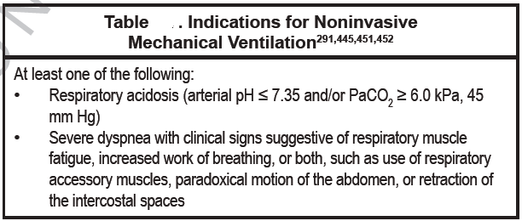
Ventilatory Support
Noninvasive mechanical ventilation

Slide 34
Contraindication
Nonavailability of trained person
Inability to protect airway
Haemodynamic instability
Inability to fix interface
Severe GI symptoms
Life threating hypoxia
Copious secretion

Slide 35
Evidence
AECOPD(evidence-A) > asthma exacerbation (C)
NIV success rate is 80-85 % in COPD

Slide 36
Practical application
Bronchodilator
Fine tune; patient, interface, machine
Mode; spontaneous or spontaneous-time , PSV on conventional ventilators
Start with low pressures IPAP-6-8, EPAP-2-4
FiO2 as required
Titrate pressures
Monitor; triggering, TV, RR, patient comfort, respiratory distress, failure, ABG
Sedation; DEXEM

Slide 37
Advantages of NIV
Improve acute respiratory acidosis
Decrease Respiratory rate
↓Work of breathing
↓ Severity of breathlessness
↓ Complications such as VAP
↓ Length of hospital stay
↓ Mortality
↓ Intubation rates
Post extubation
(Evidence A)

Slide 38
Disadvantages
Major; delay in intubation
Minor

Slide 39
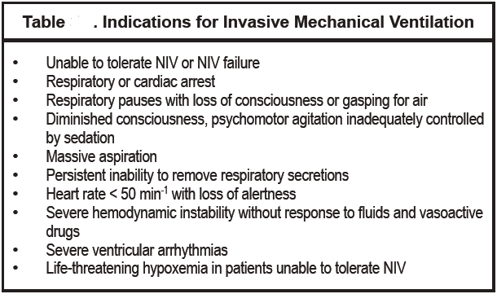
Invasive mechanical ventilation.

Slide 40
Mode AC-VCV preferred
TV; 8-10 ml
RR, Minute ventilation according to PaCO2/PH
PEEP; if no auto-PEEP-0, in presence of auto-PEEP-80% of auto-PEEP
FiO2 according to oxygenation
Adequate sedation, avoid muscle relaxant

Slide 41
Auto-PEEP
↓ Inspiratory Time or ↑ Expiratory Time or
↑ Increase Inspiratory Flow rate or Bronchodilator

Slide 44
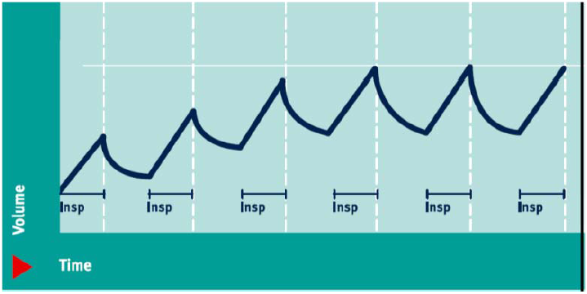
Dynamic hyperinflation

Slide 45
Air trapping/PEEPi
During inspiration
During expiration
Exaggerated RV filling
Increased intrathoracic pressure
Decreased cardiac out put
Paradoxical IV septal motion
Impaired LV filling
Impairs ventricular diastolic filling

Slide 46
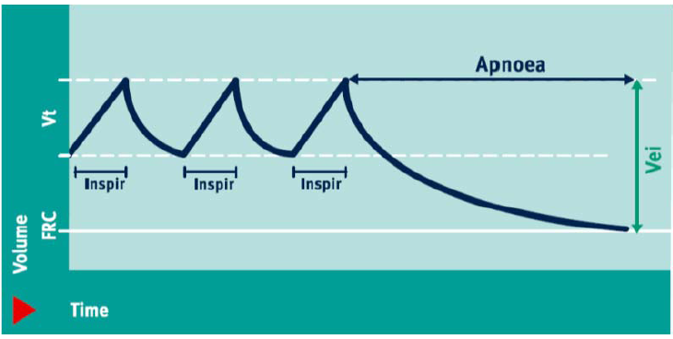
Treatment; disconnect the ventilator

Slide 47
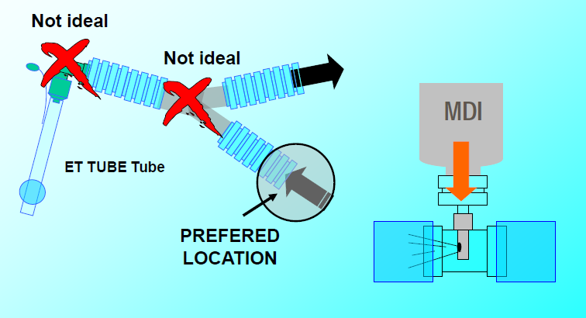
Bronchodilator

Slide 48
Discharge Criteria

Slide 49
PREVENTION OF COPD EXACERBATIONS
Smoking cessation
Influenza and pneumococcal vaccines
Patient education & compliance with medications
Pulmonary rehabilitation
Emotional & social support

Slide 50
Thank you

