Slide 1
Pulmonary Embolism
Sananta Kumar Dash
MD (Anesthesiology), FNB (CCM), EDICM, FCCP

Slide 2
Diagnosis
Risk stratification
Treatment
Long term prophylaxis

Slide 3
Introduction
PULMONARY EMBOLISM
When a patient presents with
Dyspnea
Chest pain
And/or sustained hypotension
(without an alternative obvious cause)
But, this diagnosis is followed by a confirmatory test only in about 20% of patients.
Even lower in United States, where the threshold to perform a workup for pulmonary embolism is particularly low.
Righini M et al.Lancet 2008; 371:1343-52.

Slide 4
So are we over threatened by PE????

Slide 5
International Cooperative Pulmonary Embolism Registry
(ICOPER)
Goldhaber SZ et al.(ICOPER)Lancet 1999;353:1386-9.
PATIENT TYPE | DEATH RATE
HEMODYNAMICALLY STABLE PE | 58%
HEMODYNAMICALLY UNSTABLE PE | 15%

Slide 6
Risk assessment

Slide 7
Risk Factors | Points
Age older than 65 y | 1
Previous DVT or pulmonary embolism | 3
Surgery (under general anesthesia) or fracture (of the lower limbs) within 1 month | 2
Active malignant condition (solid or hematologic, currently active or considered cured < 1 y) | 2
Symptoms
Unilateral lower limb pain | 3
Hemoptysis | 2
Clinical Signs
Heart rate 75-94 beats/min | 3
Heart rate ≥95 beats/min | 5
Pain on lower limb deep venous palpation and unilateral edema | 4
Clinical Probability | Score
Low | 0-3 total
Intermediate | 4-10 total
High | ≥11 total
Revised Geneva score. Ann Intern Med. 2006 Feb 7;144(3):165-71.

Slide 8
Modified Wells Prediction Rule
Clinical Characteristic | Score
Previous pulmonary embolism or deep vein thrombosis | + 1.5
Heart rate >100 beats per minute | + 1.5
Recent surgery or immobilization (within the last 30 d) | + 1.5
Clinical signs of deep vein thrombosis | + 3
Alternative diagnosis less likely than pulmonary embolism | + 3
Hemoptysis | + 1
Cancer (treated within the last 6 mo) | + 1
Clinical Probability of Pulmonary Embolism | Score
Low | 0-1
Intermediate | 2-6
High | ≥6
Am J Med, Vol. 113,pp 269-75,2002.

Slide 9
Suspected Pulmonary Embolism
Dyspnea/Chest pain/Sustained hypotension
Clinical probability assessment
Revised Geneva score/Modified Well’s score
Hemodynamically stable
Hemodynamically unstable

Slide 10
Hemodynamically stable
Low or intermediate
clinical probability
High clinical
probability
D-Dimer testing
No role of d-dimer in high clinical probability case
Normal
Elevated
Multi.CT
+
No PE
Negative
PE

Slide 11
Hemodynamically unstable
Not critically ill
Critically ill & high clinical probability
No role of d-dimer in clinically unstable case. Echo can replace a CT in critically ill patients
Multi. CT if available
Multi. CT not avilable
+
TTEcho/TEE
Negative
PE
RV dysfunction
No RV dysfunction
Search other causes

Slide 12
Chest X ray
12% of angiographically positive PE have a normal chest radiographs .
Most common- atelectasis and/or parenchymal opacities in the affected lung zone
Pleural effusions within the affected hemithorax occurredin approximately 35% of patients with PE.
PIOPED 1 383 patients

Slide 13
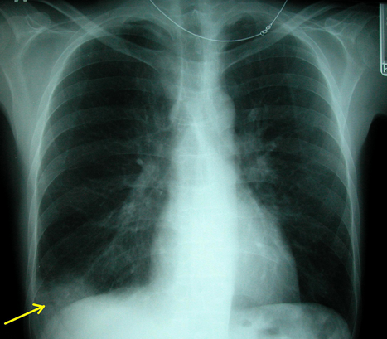
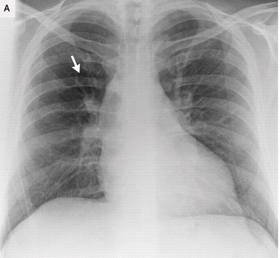
Fleishner sign - enlarged pulmonary artery (20%)
Pala’s Sign- enlarged right descending pulmonary artery is seen on the chest x-ray
Hampton hump - peripheral wedge of airspace opacity and implies lung infarction (20%)
Westermark sign - regional oligaemia and highest positive predictive value (10%)
pleural effusion (35%)

Slide 14
V/Q scan

Slide 15
Ventilation –Perfusion scan
A normal ventilation–perfusion scan essentially rules out pulmonary embolism, with a negative predictive value of 97%.
A lung scan with findings that suggest a high probability of pulmonary embolism has a positive predictive value of 85 to 90%.
However, ventilation–perfusion scanning is diagnostic in only 30 to 50% of patients with suspected pulmonary embolism.
Sostman HD.Radiology 2008;246:941-6.

Slide 16
CT Angio
97% sensitive for emboli in the main pulmonary arteries
van Belle A et al JAMA 2006;295:172-9.

Slide 17
D-Dimer
The use of the d-dimer assay is of limited value in patients with a high clinical probability of pulmonary embolism.
The specificity of an increased d-dimer level is reduced in patients with cancer, pregnant women, and hospitalized and elderly patients.
1.Tapson VF. AJR Am J Roentgenol 2009;193:425-30.
2. Bruinstroop E. The use of D-dimer in specific clinical conditions: a narrative review. Eur J Intern Med 2009;20:441-6.

Slide 18
Right ventricular dysfunction
Associated with increased mortality among patients with acute pulmonary embolism.*
RV hypokinesia and dilatation- independent predictors of 30-day mortality in hemodynamically stable patients.**
RV dysfunction (assessed by means of multidetector CT) has been suggested to be an independent predictor of 30-day mortality.***
*Grifoni S et al. Circulation 2000; 101:2817-22.
**Frémont B et al. Chest 2008;133:358-62.
***Sanchez O et al; Am J Respir Crit Care Med 2010;181:168-73.

Slide 19
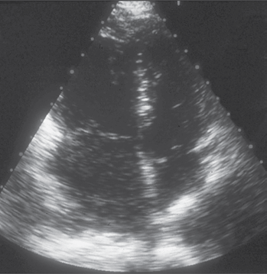
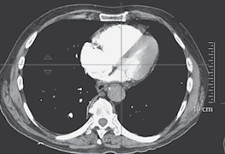
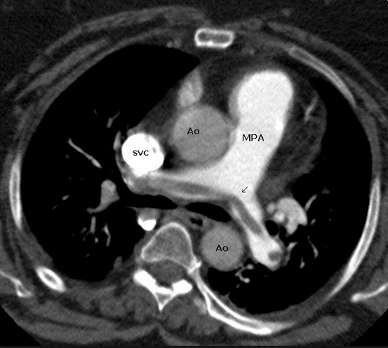
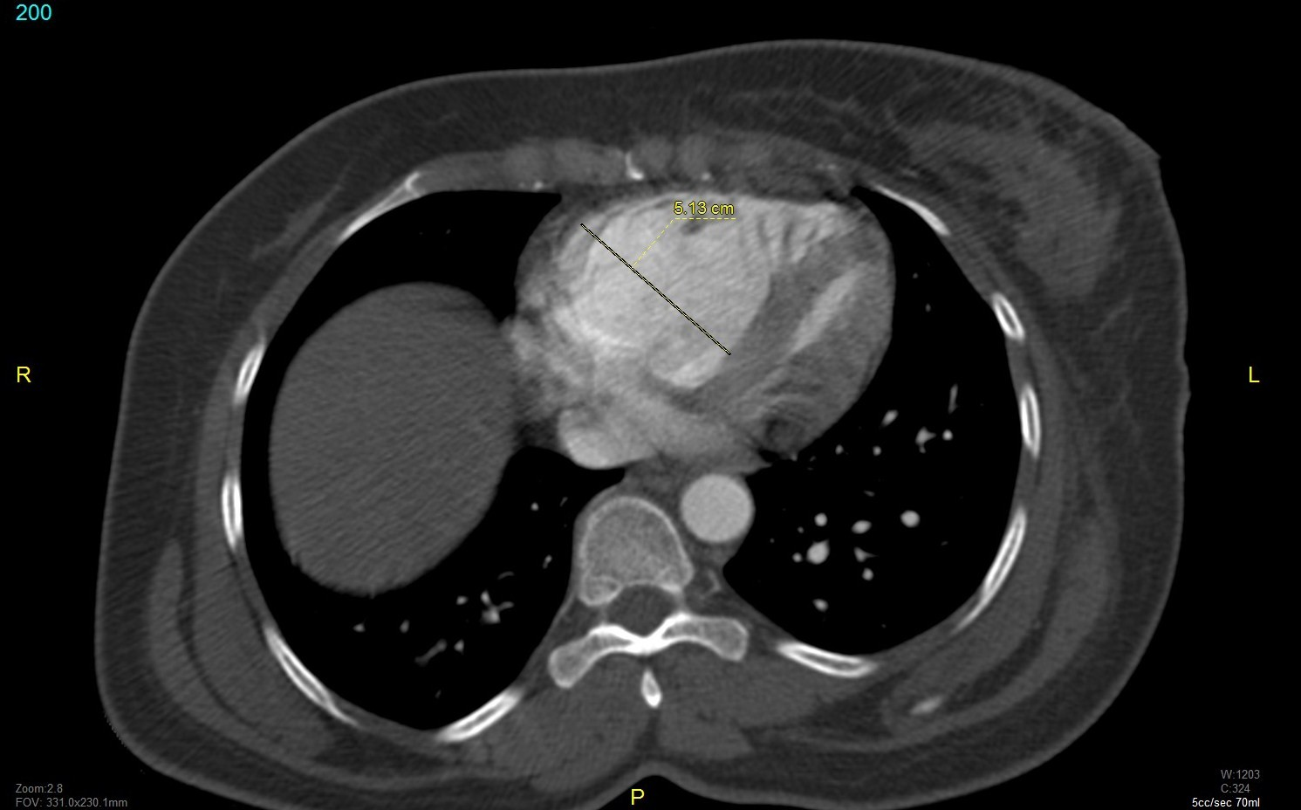

Slide 20
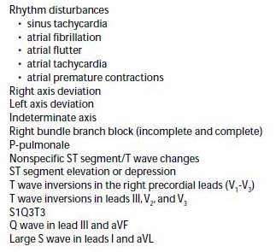
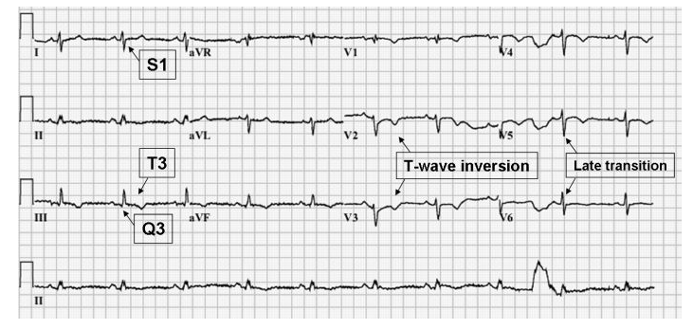
ECG disturbances

Slide 21
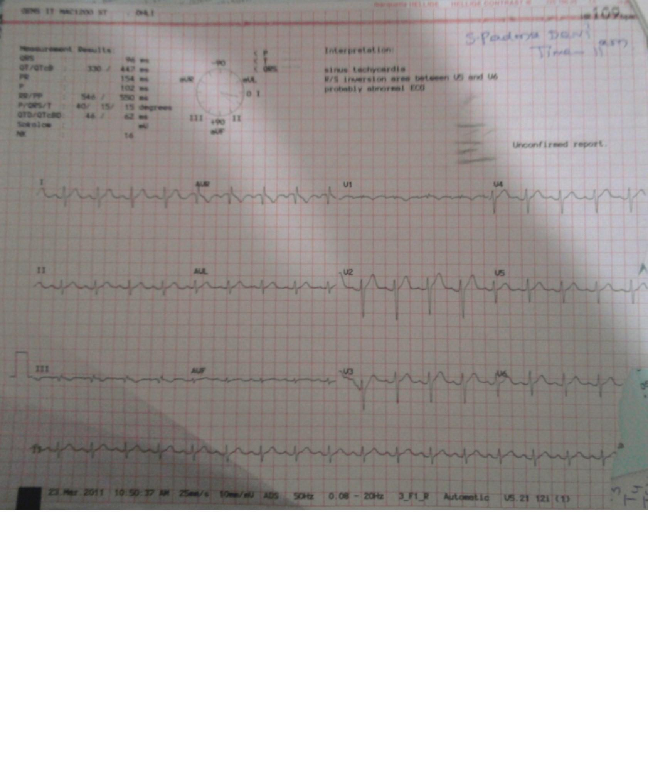
S1
Q3T3

Slide 22
BNP and Pro-BNP
↑B-type natriuretic peptide (BNP)
↑pro- BNP
risk of an adverse in-hospital outcome*
↑ short-term risk of death by a factor of 5.2
↑ risk of death from pulmonary embolism by a factor of 9.4 **
Prognostic role of troponin in hemodynamically stable patients***
↑Troponin
*Klok FA et al Am J Respir Crit Care Med 2008;178:425-30.
**Jiménez D et al.Eur Respir J 2008;31:847-53.
***Binder L et al. Circulation 2005; 112:1573-9.

Slide 23
Treatment
Severity dependent treatment

Slide 24
Massive PE : Acute PE with sustained hypotension (SBP <90 mm Hg for at least 15 minutes or requiring inotropic support)
Submassive PE : Acute PE without systemic hypotension (systolic blood pressure >90 mm Hg) but with either RV dysfunction or myocardial necrosis.
RV dysfunction- at least 1 of the following:
RV dilation (apical 4-chamber RV diameter divided by LV diameter >0.9) or RV systolic dysfunction on echocardiography
RV dilation (4-chamber RV diameter divided by LV diameter 0.9) on CT
Myocardial necrosis
Elevation of BNP (90 pg/mL)
Elevation of N-terminal pro-BNP (500 pg/mL); or
Electrocardiographic changes (new complete or incomplete
right bundle-branch block, anteroseptal ST elevation
or depression, or anteroseptal T-wave inversion)
Myocardial necrosis is defined as either of the following:
Elevation of troponin I (0.4 ng/mL) or
Elevation of troponin T (0.1 ng/mL)
Low-risk PE : Acute PE and the absence of the clinical markers of adverse prognosis that define massive or submassive PE.

Slide 25
PE
Submassive without RV strain (low risk PE)
Submassive with RV strain (Abnormal echo or biomarkers)
Systolic BP<90 for >15 min
Heparin anticoagulation
Heparin anticoagulation
Heparin anticoagulation
Evidence of shock(SBP<90)/respiratory failure(SPO2<95%)/Altered mental status/
RV dysfunction(RV hypokinesia/VSP>40 mm Hg)/Tropnin above boderline value/BNP>100pg/ml/pro-BNP>900pg/ml)
Thrombolyse if no C/I

Slide 26
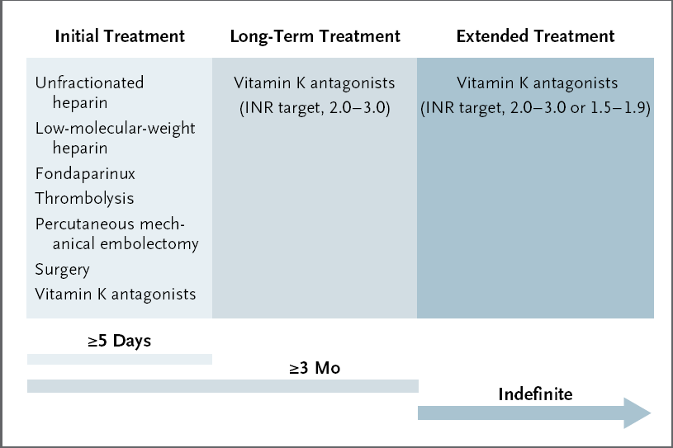

Slide 27
Treatment ---- Anticoagulation
In patients with a high clinical probability of pulmonary embolism, anticoagulant treatment should be initiated while diagnostic confirmation is awaited.
Smith SB et al .Chest 2010.

Slide 28
Anticoagulation dosing
Enoxaparin1mg/kg | SC | BD
Fondaparinux 5mg <50 kg 7.5mg 50-100kg 10mg >100kg | SC | OD
UFH 80 IU bolus f/b 18 IU/kg/hr with target aPTT 1.5 to 2.5 | IV | Infusion

Slide 29
Points to remember
Low-molecular-weight heparins and fondaparinux are preferred over unfractionated heparin for their ease of use.
Treatment with a weight-adjusted lowmolecular- weight heparin had an efficacy and safety profile similar to that of intravenous unfractionated heparin.*
Fondaparinux was shown to be as effective and safe as intravenous unfractionated heparin in a large, open-label study.**
Since low-molecular-weight heparins and fondaparinux are excreted by the kidneys, unfractionated heparin should be considered in patients with a creatinine clearance of less than 30 ml per minute.
*Quinlan DJ, Ann Intern Med 2004; 140:175-83.
**The Matisse Investigators. N Engl J Med 2003;349:1695-702

Slide 30
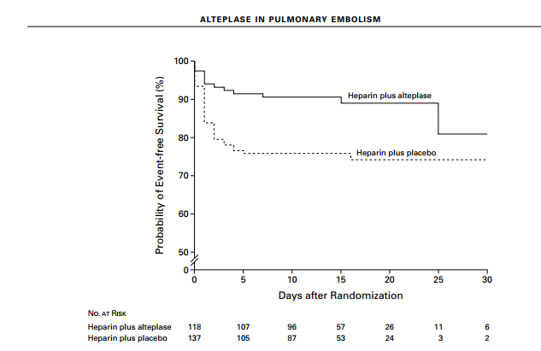
Thrombolysis in hemodynamically stable patient
Thrombolysis reduced the rate of clinical deterioration but not the rate of death, as compared with the use of unfractionated heparin.
Intravenous thrombolytic treatment was associated with a more rapid resolution of right ventricular dysfunction
Event free survival

Slide 31
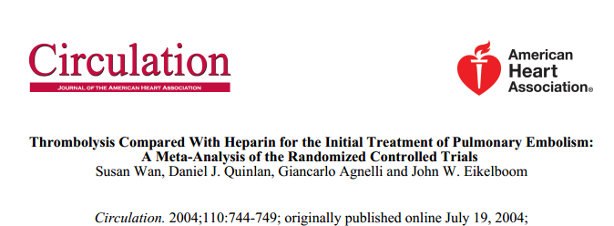
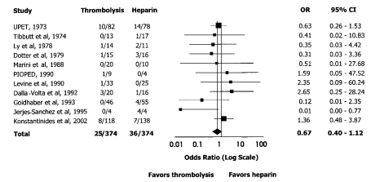
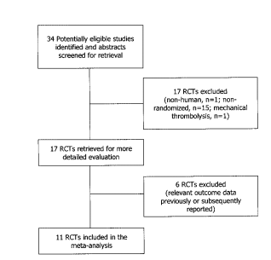

Slide 32
Thrombolysis in hemodynamically unstable patient
Candidates for more aggressive treatment, such as pharmacologic or mechanical thrombolysis.
Mortality can be as high as 60% in untreated patients (and even higher in patients with right heart thrombi) and can be reduced to less than 30% with prompt treatment.
Major bleeding was more common with intravenous thrombolysis than with anticoagulant therapy.
Wan S et al. Circulation 2004;110:744-9.

Slide 33
Checklist for thrombolysis
Exclusion criteria for tPA in submassive PE:
Age > 80
Hemodynamic instability (SBP < 90 mmHg)
Onset of symptoms > 96 hours
Thrombolytic treatment, major surgery, or biopsy < 7 days ago; major trauma < 10 days ago
CVA, TIA, craniocerebral trauma, or neurosurgery < 6 months ago
GI bleeding < 3 months ago
Uncontrolled HTN
Known bleeding disorder or diabetic retinopathy
Current therapy with oral anticoagulant; Current pregnancy or lactation
Life expectancy < 6 months because of underlying disease
Kearon C et al, Chest 2008;133:Suppl:454S-545S.

Slide 34
Dosing and Action
drug | FDA indication | Direct plasminogen activation? | dose
Streptokinase | Yes | No | 250 000-IU IV bolus followed by 100 000-IU/h infusion for 12–24 h
Urokinase | Yes | No | 4400-IU/kg bolus, followed by 4400 IU /kg/hr for 12–24 h
Alteplase | Yes | Yes | 100-mg IV infusion over 2 hr
Reteplase | No | Yes | Double 10-U IV bolus 30 min apart
Tenecteplase | No | Yes | Weight-adjusted IV bolus over 5 sec (30–50 mg with a 5-mg step every 10 kg from 60 to 90 kg)

Slide 35
Anticoagulant dosing with thrombolytic
Intravenous unfractionated heparin is the only anticoagulant that has been used in conjunction with thrombolytic therapy in patients with pulmonary embolism.
5000 U heparin bolus given before tPA and heparin infusion started concomitantly with tPA.

Slide 36
Level of evidence for thrombolysis
situation | Indication grade
massive acute PE | Class IIa; Level of Evidence B
submassive acute PE | Class IIb; Level of Evidence C
low-risk PE | Class III; Level of Evidence B
undifferentiated cardiac arrest | not recommended
Circulation April 26, 2011

Slide 37
Catheter-directed therapy had a clinical success rate of 86% and a rate of major procedural complications of 2.4% .
Catheter-directed therapy was a relatively safe and effective treatment for acute massive pulmonary embolism.
Percutaneous mechanical thrombectomy (thrombus fragmentation and aspiration) and surgical embolectomy should be restricted to high-risk patients with an absolute contraindication to thrombolytic treatment and those in whom thrombolytic treatment has not improved hemodynamic status
Percutaneous mechanical thrombectomy is an alternative to surgical embolectomy in cases in which immediate access to cardiopulmonary bypass is unavailable.

Slide 38
IVC filter
Adult patients with any confirmed acute PE (or proximal DVT) with contraindications to anticoagulation or with active bleeding complication (Class I; Level of Evidence B).
Anticoagulation should be resumed in patients with an IVC filter once contraindications to anticoagulation or active bleeding complications have resolved (Class I; Level of Evidence B).
Circulation April 26, 2011

Slide 39
Vitamin K antagonists
Vitamin K antagonists should be initiated as soon as possible, preferably on the first treatment day, and heparin should be discontinued when the international normalized ratio (INR) has been 2.0 or higher for at least 24 hours.

Slide 40
Risk factors for recurrence
male sex
advanced age
idiopathic or unprovoked pulmonary

Slide 41
Long term Therapy
Temporary (reversible) - vitamin K antagonists should be given for 3 months.
Unprovoked pulmonary embolism, those with cancer, and those with recurrent unprovoked pulmonary embolism are candidates for indefinite anticoagulation with periodic reassessment of the risk– benefit ratio.
Conventional-intensity warfarin therapy (INR target, 2.0 to 3.0) is recommended during the first 3 to 6 months after the acute event; after an initial course of conventional intensity warfarin therapy, low-intensity warfarin therapy (INR target, 1.5 to 1.9) may be an option.
Low-molecular-weight heparins should be chosen over warfarin for long-term therapy in patients with cancer and pregnant women

Slide 42
Thank you

