Slide 1
Prosthetic Valve Endocarditis
Sananta Kumar Dash
MD (Anesthesiology), FNB (CCM), EDICM, FCCP

Slide 2
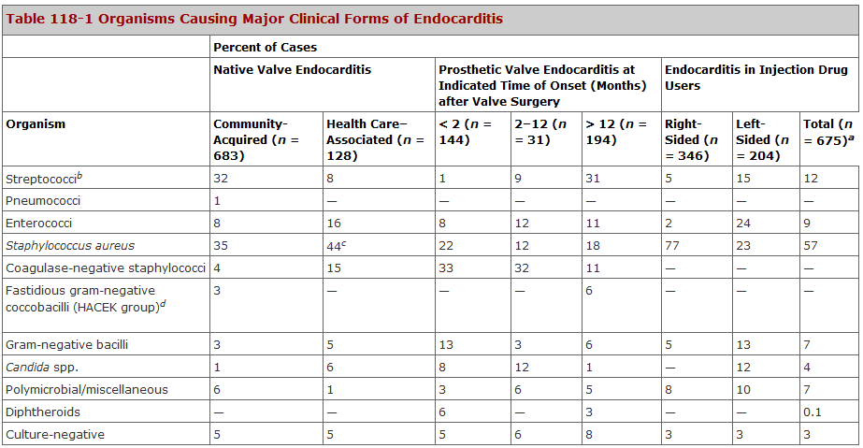
Microbiology
Up to 12 mnth | CONS
> 12 month | Strept

Slide 4
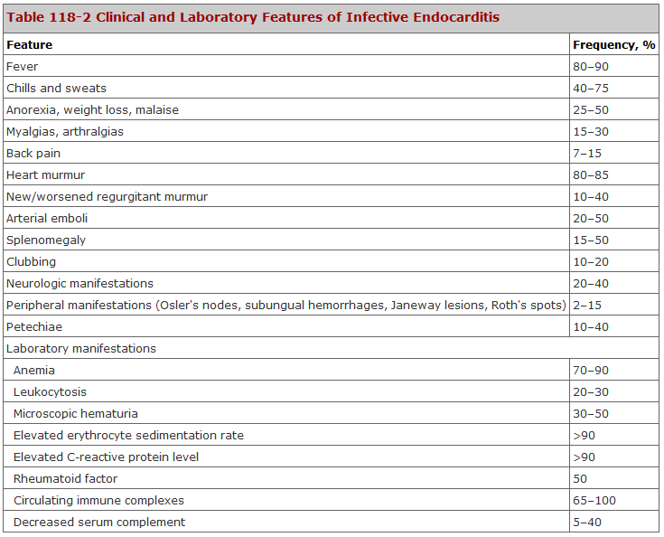

Slide 5
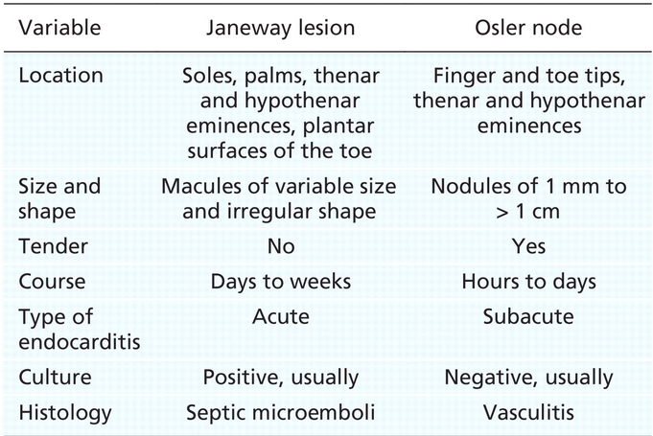
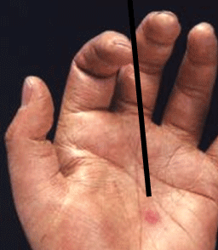

Slide 6
Complications
CARDIAC MANIFESTATIONS
Murmur | 85%
CHF | 30-40% (Valvular dysfunction, myocarditis, intracardiac fistula
Perivalvular abscess
Pericardiatis, Heart block | Extension of abscess
Emboli of coronary artery

Slide 7
Complications
Non Cardiac
Uncontrolled infection
Systemic embolism | Occurs after adequate Abx treatment, within 2weeks of therapy Risk- size, mobilty, location, organism (staph/Strepto/Candida), previous embolism,multi-valvular)
CNS | Stroke, TIA, meningitis, brain abscess,
Infectitious aneurysm | Septic arterial embolism to the vasa-vasorum- intracranial (mc)
ARF
Spleenic abscess

Slide 8
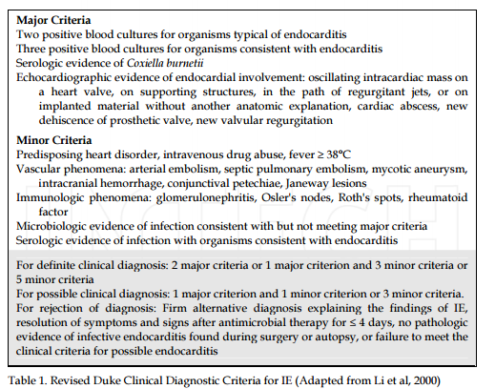

Slide 9
Diagnostic evaluation
Culture - blood
Culture tissue |  | Post Sx only
Histological | Electron microscopy- | Time/expense
Immunological | Indirect IF, ELISA- Coxiella burnetii, Bartonella, Legionella | *Staph (recent report)
Molecular Biology | PCR | Rapid & reliable detection of Fastidious/non-culturable organisms. Useful in negative culture due to previous use of Abx
ECHO(TTE & TEE)
Multislice CT | IE-associated valvular abnormalities, abscess & aneurysm

Slide 10
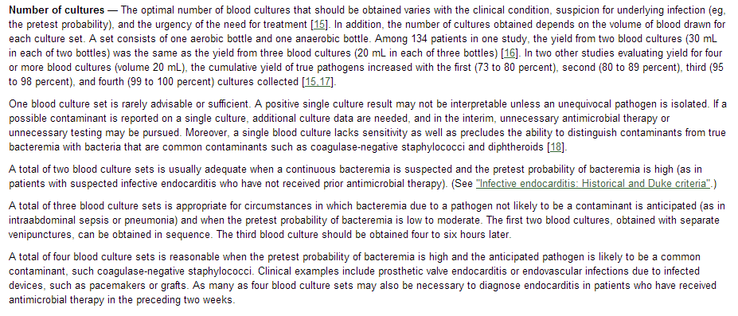
Number of Cultures

Slide 11
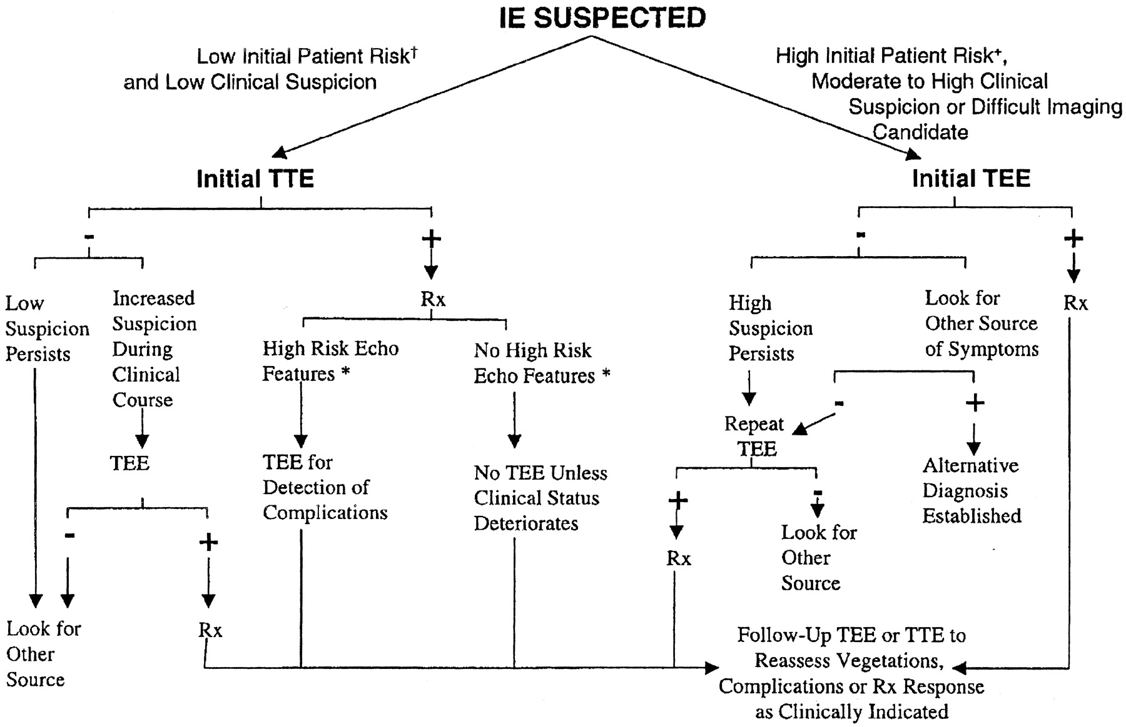
An approach to the diagnostic use of echocardiography (echo).
*High-risk echocardiographic features include
Large and/or mobile vegetations
Valvular insufficiency
Suggestion of perivalvular extension, or secondary ventricular dysfunction
Larry M. Baddour et al. Circulation. 2005;111:e394-e434
Copyright © American Heart Association, Inc. All rights reserved.
Notes:
An approach to the diagnostic use of echocardiography (echo). *High-risk echocardiographic features include large and/or mobile vegetations, valvular insufficiency, suggestion of perivalvular extension, or secondary ventricular dysfunction (see text). †For example, a patient with fever and a previously known heart murmur and no other stigmata of IE. +High initial patient risks include prosthetic heart valves, many congenital heart diseases, previous endocarditis, new murmur, heart failure, or other stigmata of endocarditis. Rx indicates antibiotic treatment for endocarditis. Reproduced with permission from: Bayer AS, Bolger AF, Taubert KA, Wilson W, Steckelberg J, Karchmer AW, Levison M, Chambers HF, Dajani AS, Gewitz MH, Newburger JW, Gerber MA, Shulman ST, Pallasch TJ, Gage TW, Ferrieri P. Diagnosis and Management of Infective Endocarditis and Its Complications. Circulation. 1998;98:2936–2948.

Slide 12
Staphylococcus
 |  | Points
MSSA | Nafcillin/Oxacillin+Gent+Rifampin | Triple therapy
MRSA | Vancomycin+Gent+Rifampin | Rifampin- synergistic/ based on retrospective studies (More culture negative histopath tissue)
Pn allergy (No anaphylaxis/swelling) | Cephalosporin (1st Gen)+Gent+Rifampin | Staph PVE – Sx is highly recommended
Duration | PN+Rifampin- 6weeks Gent-2 weeks
Resistant to Gent | Nafcillin/Oxacillin+Refampin+Fluroquinolone-6weeks
Resistant to Gent & Fluroquinolone | Lenezolid/Ceftriaxone/TMP-SMZ (2 weeks)
If breakthrough bacteremia/microbilogical failure in Pt receiving Vancomycin | High dose Daptomycin alone/Ceftriaxone/Daptomycin+cefttazoline/Linezolid

Slide 13
Streptococcus
Beta Lactam + Aminoglycosisde | Pn+Gent (MIC<0.12) Gent- 2 weeks
 | If relatively resistant to PN- Aminoglycoside (6 weeks)
Aminoglycoside C/I | Pn/Cephalosporin/Vancomycin alone
Pn Allergy (Immediate type reaction- Anaphylaxis, Urticardia) | Vancomycin
Pn Allergy (Non-immediate type reaction) | Cefotaxime/Ceftriaxone

Slide 14
Enterococcus
Sensitive strain | Pn+Aminoglycoside
Gent resistant | Also cross resistant to Nitilmycin, Tobra, Amikacin, Kanamycin… but Streptomycin and gentamycin resistance is coded by different genes… worth testing for streptomycin
Resistant to both Gent & Strepto | Continue Pn/ Vancomycin 8-12 weeks
Pn allergy | Vancomycin+Aminoglycoside No cephalosoprin is recommended
VRE faecium | Quinopristin+Dalfopristin
VRE faecium/ fecalis | Linezolid/Daptomycin
Surgical intervention

Slide 15
Others
Organism | Regime
HACEK | Ceftriaxone/Cefotaxime (3rd gen)
Corynebacterium | Gentamycin
GNB (Pseudomonas) | Susceptibility High dose Tobramycin + Pipercillin/Cefepime/Ceftazidime
Fungi | Antifungal + valve replacement
Candida | Amphotericin
Aspergillus/Mucur | Increase dose of Amphotericin Amphotericin+Flucytosine
 | Suppressive therapy (Oral fluconazole (200-400 OD long term/life long)

Slide 17
Indications for surgery in IE
Indications | Pathophysiological process
CHF | Severe aortic regurgitation Valve obstruction caused by vegetations Severe acute aortic regurgitation with echocardiographic signs of elevated left ventricular end-diastolic pressure or significant pulmonary hypertension Prosthetic dehiscence or obstruction
Periannular extension | Abscess/Fistula
Vegitation | Recurrent Large vegetations (> 10 mm) after 1 or more clinical or silent embolic events after the initiation of antibiotic therapy Very large vegetations (> 15 mm) without embolic complications
Cerebrovascular complications
Persistent sepsis | Fever or positive blood cultures persisting for > 5 to 7 days despite an appropriate antibiotic regimen (Extracardiac sources excluded)
Relapsing IE | For prosthetic valve
Difficult organisms | S. aureus IE involving a prosthetic valve,

Slide 18
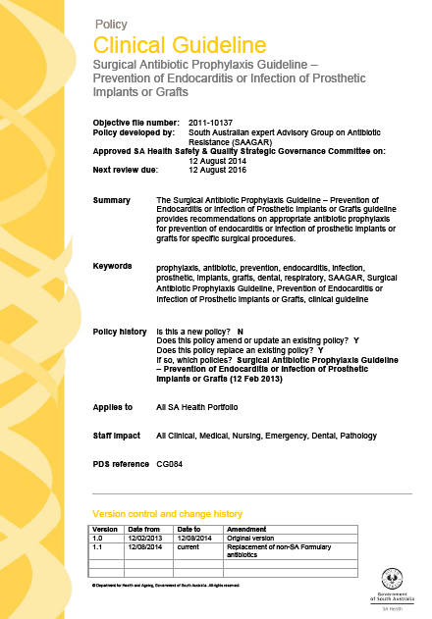
Surgical Antibiotic Prophylaxis Guidelines Prevention of Endocarditis or Infection of Prosthetic Implants or Grafts

Slide 19
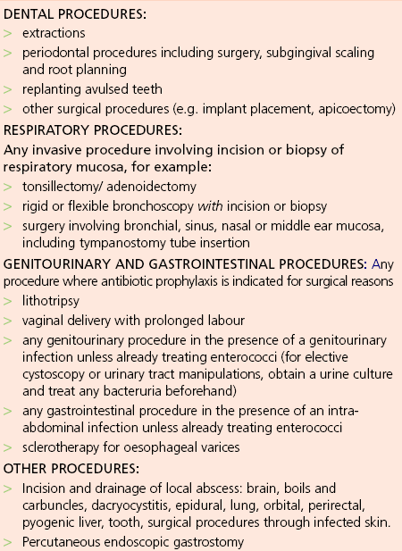
PROPHYLAXIS ALWAYS REQUIRED

Slide 20
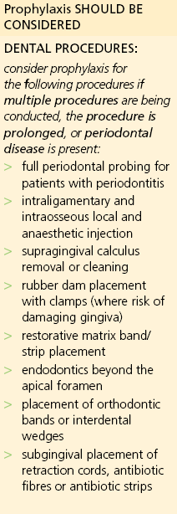
PROPHYLAXIS SHOULD BE CONSIDERED

Slide 21
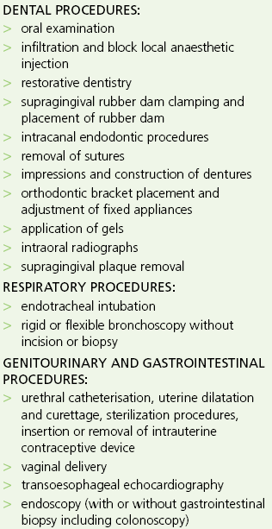
PROPHYLAXIS NOT REQUIRED

