Slide 1


ECMO in ADULT population
Literature review
Sananta Kumar Dash
MD (Anesthesiology), FNB (CCM), EDICM, FCCP

Slide 2
ECMO in Adult
Indications-
ECMO
Cardiac
E-CPR
Post Cardiac Sx
Respiratory
Cardiogenic shock
Bridge for intervention
Both
Infection
Viral
Bacterial
ILD/Bridge to transplant
ARDS
Non-infectious
Trauma
Secondary
Acute PE
CO2 removal

Slide 3
ECMO in Respiratory failure

Slide 4
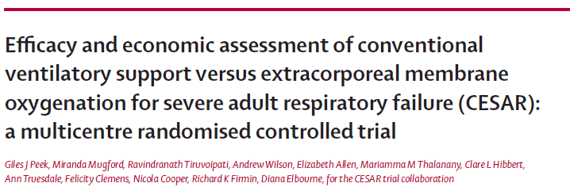
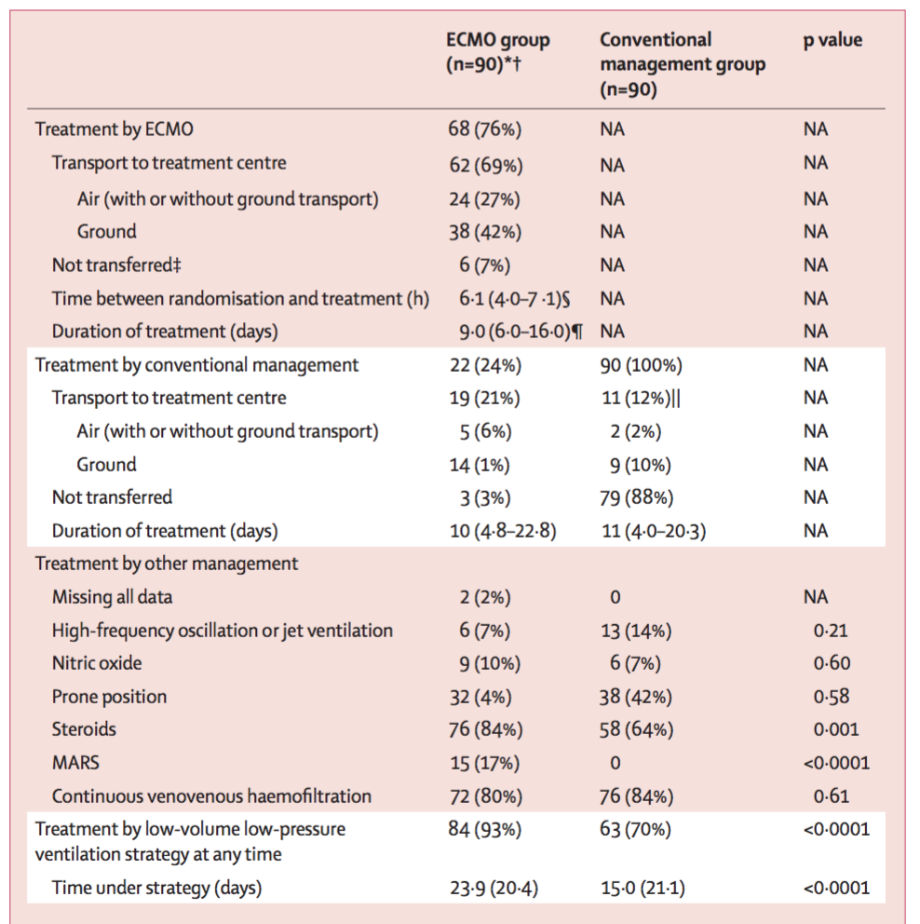
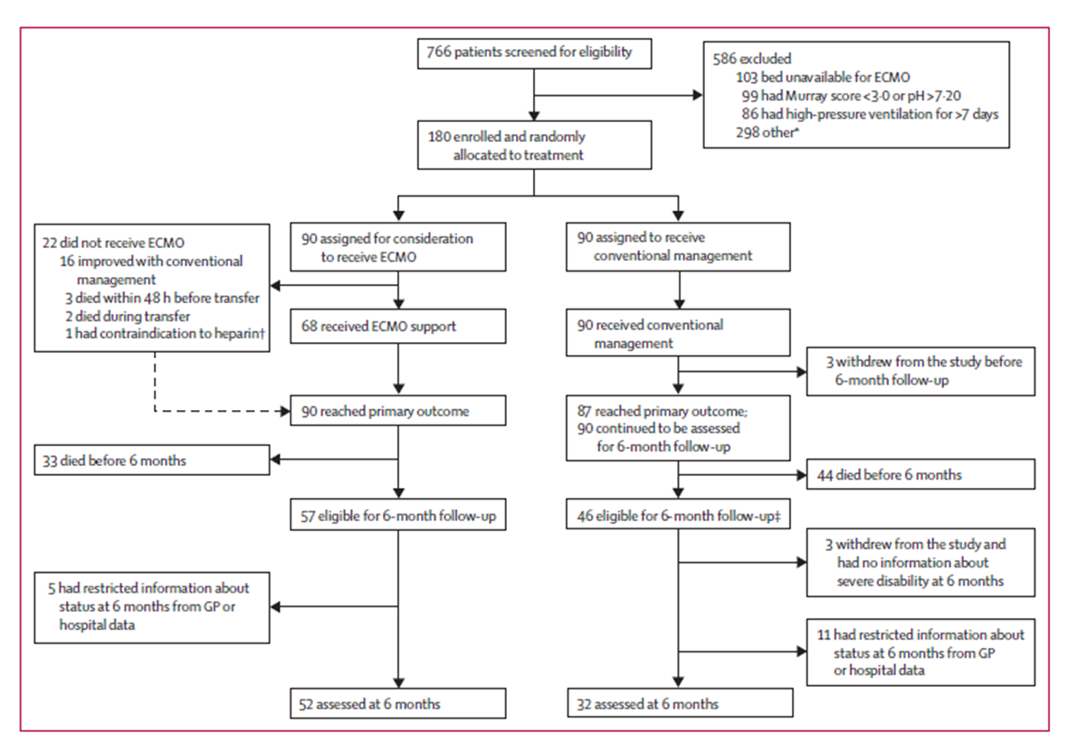
ECMO- ARDS
Lancet 2009; 374: 1351–63
Notes:
The first clinical trial that evaluated role of ECMO in adults with ARDS.
It was a multicentre RCT which evaluated ECMO against standard ventilation for ARDS in UK.
It involved 99 tertiary ICUs and 11 referral ICU.
METHOD
If the patient satisfied the inclusion criteria they were referred to Glenfield Hospital, Leicester. The referred patients were given a trial of 12 hours with conventional ventilation (Though they used steroids in this group in addition). If the patients did not improve and still qualified for the inclusion (i.e Murray score≥ 3, pH <7.2), they were put on ECMO.
RESULT
There were 90 patients each in the ECMO (Managed in Glenfield Hospital, Leicester) and conventional management group i.e PCV, low pressure, low volume ventilation (ARDS net only in 84% patients in ECMO group vs 64% in conventional group) or HFOV (managed in respective hospitals).
Out of 90, 22 patients did not receive ECMO (17 managed conventionally and 5 either died before or during transport). ECMO was not used in transport of these patients.
The study results were impressive.
57 patients out of 90 on ECMO survived after 6 moths with no disability compared to 41 out of 87 patients in conventional group (NNT=5).
LIMITATIONS
This study had multiple flaws which included the application of ECMO confined to a single center, 24% of the patients designated to receive ECMO eventually did not receive it, lack of any stringent study protocol (93% vs 70% patients were managed with ARDSnet protocol in ECMO and non-ECMO group respectively).
Even if with so many faults this study opened a gateway for the future research.

Slide 5
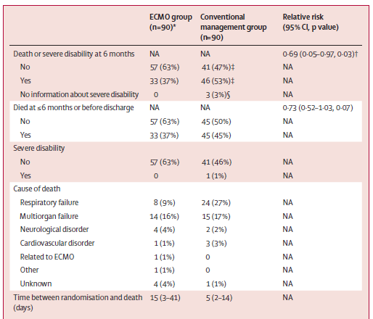
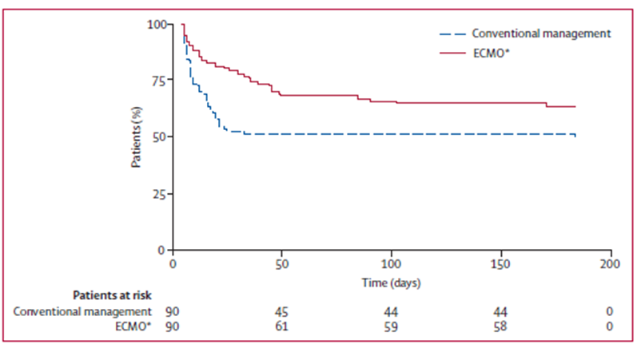

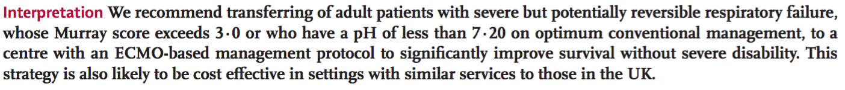
ECMO- ARDS
Lancet 2009; 374: 1351–63

Slide 6
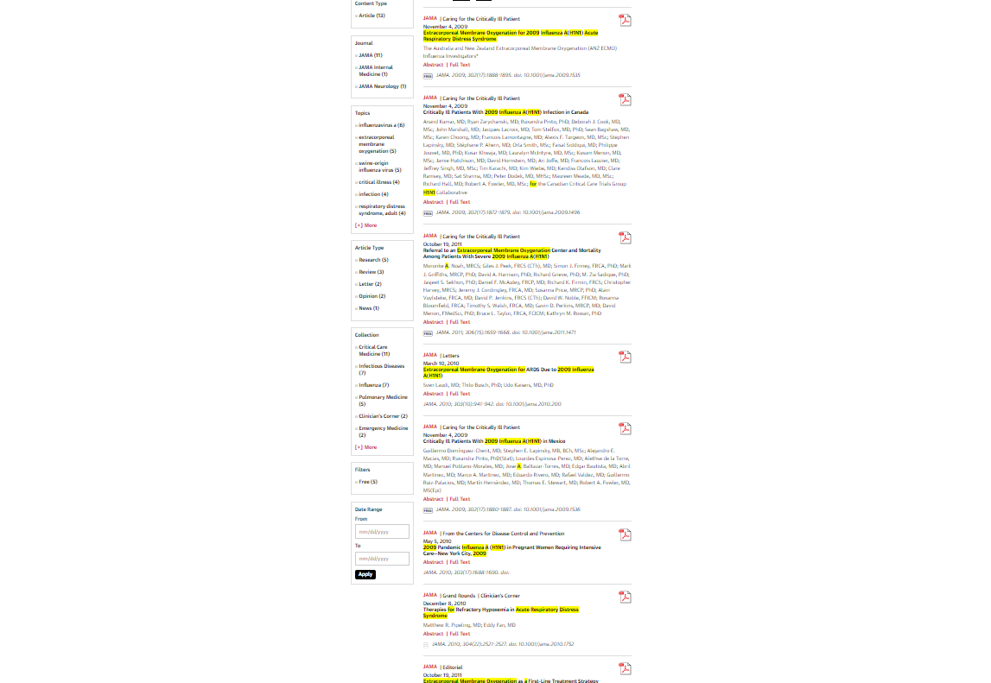
H1N1+ARDS+ECMO

Slide 7
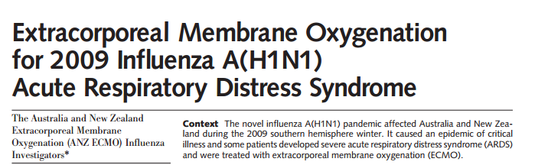
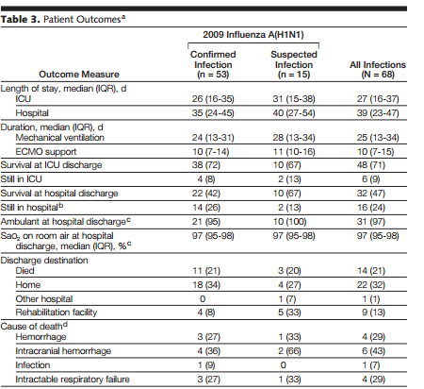
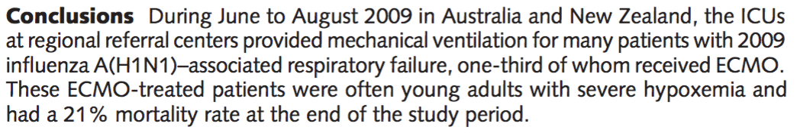
JAMA. 2009;302(17):1888-1895
Notes:
An observational study reported no definite evidence of use of ECMO in H1N1 pandemic though reported a relatively low mortality with ECMO compared to other published study on ECMO. The recruitment in to the ECMO arm was based on severity of the disease and understandably, the mortality was higher than the conventional management group as they had less severely ill patients. This study did not give any significant account of the use of ECMO and its benefit though suggested that it can be used as a rescue therapy.

Slide 8
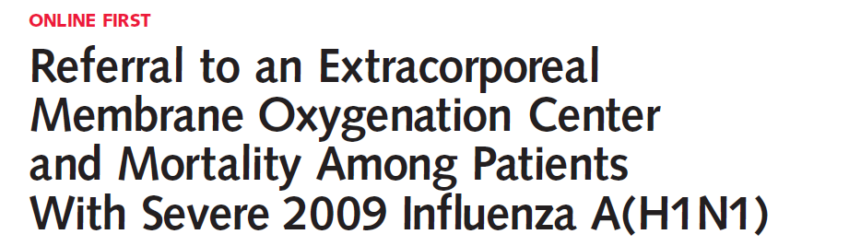
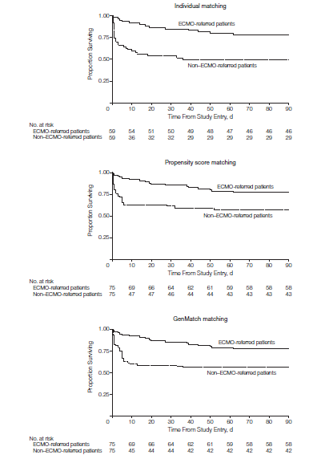
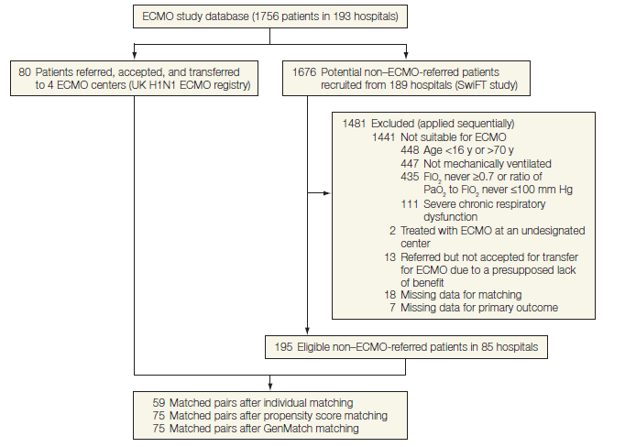
Twenty-two patients (27.5%) who had been transferred to 1 of the 4 UK ECMO centers died.
JAMA. 2011;306(15):1659-1668
Notes:
This was a cohort study including ECMO-referred patients with H1N1 related ARDS in United Kingdom who were refereed to one of the 4 ECMO enabled centers. Then the investigators pooled data from 1756 patients to identify 59 matched pairs of ECMO-referred and ECMO-non-referred patients using individual matching, 75 pairs were identified using propensity score matching and another 75 pairs were identified using GenMatch matching. There was a significant improvement of mortality demonstrated in all forms of matching in favor of ECMO treatment. The authors concluded that ECMO-referral was associated with lower hospital mortality as compared to non-ECMO-referred patients.

Slide 9
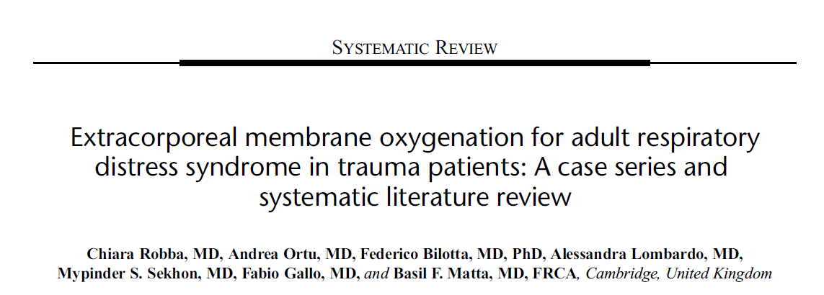
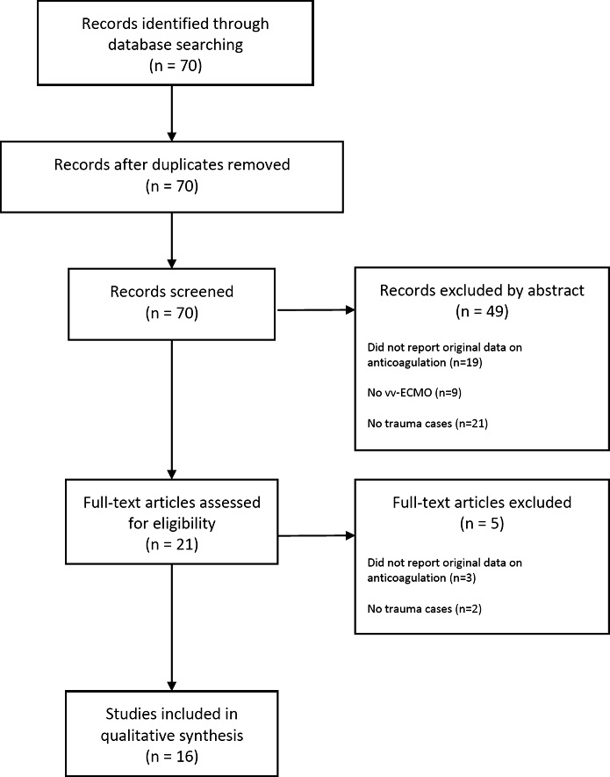
ECMO-ARDS (noninfect.)
Total of 17 studies (6 case series and 11 case reports) were included.
31 patients (14 with TBI)
Pulmonary contusion(17 cases)
Hemorrhagic shock and massive transfusion (10 cases)
Pulmonary embolism (4 cases), and Aspiration (3 cases).
Heparin bolus- 16 cases, most commonly used Dose was 5000 IU (range, 500–10000 IU)
Heparin infusion- 28 cases
No Heparin- 3 cases
Major bleed- 3 cases (All received Heparin bolus before cannulation, Target ACT>150 sec) : one case of intracranial bleeding (with concomitant TBI requiring surgical evacuation) and two patients experienced bleeding from multiple sites.
Good neuro outcome (GOS 4-5)- 23/31 patients
Death- 4 patients- 3- septic shock, 1 malignant intra cranial HTN (Not due to bleed)
J Trauma Acute Care Surg. 2017;82: 165–173.

Slide 10
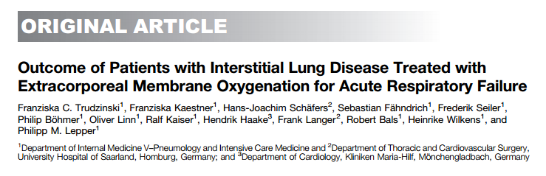
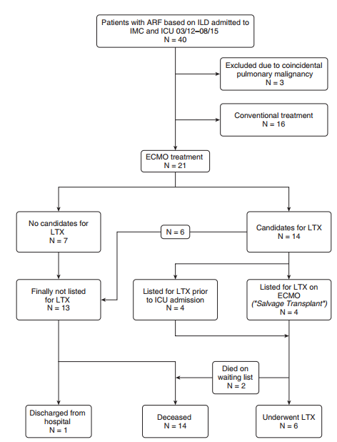
ECMO can be lifesaving as a bridge for transplant but is unhelpful in patients who are not suitable for transplant.
Am J Respir Crit Care Med Vol 193, Iss 5, pp 527–533, Mar 1, 2016

Slide 11
ECMO in CPR

Slide 12
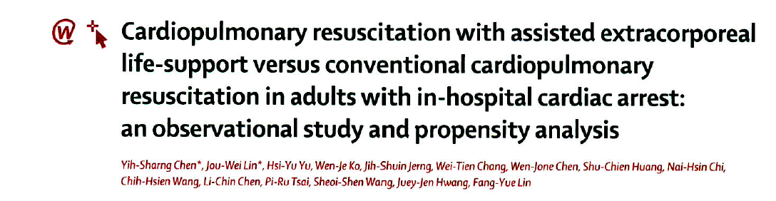
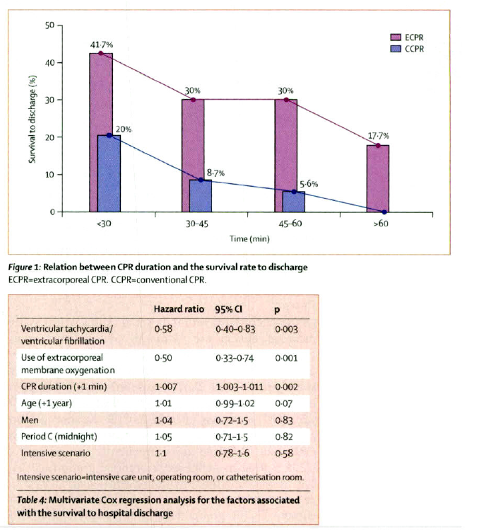
A prospective observational trial
CPR with ECMO to conventional CPR IHCA with CPR >10 minutes
113 patients received conventional CPR vs 59 received CPR with ECMO
Survival rate - 30 days (34.8% Vs 17.4%)
-1 year (19.6% Vs 13%)
The Lancet 2008; 372: 554-61

Slide 13
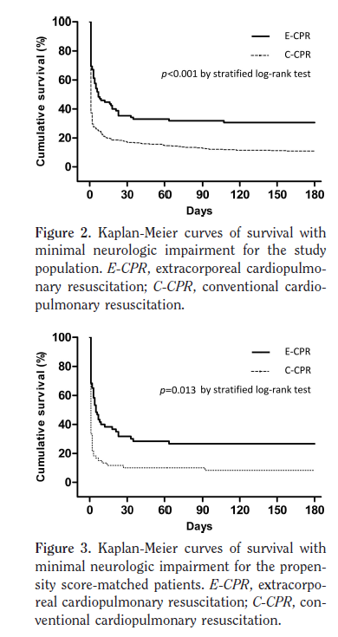
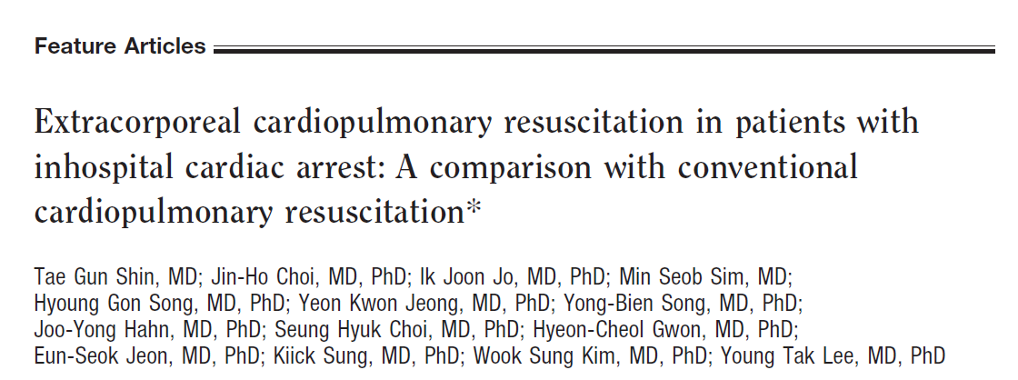
Retrospective study
120 cases IHCA
Significantly improved survival to discharge with minimal neurological impairment in patients who received ECMO as a part of CPR (odds ratio, 0.17; 95% confidence interval, 0.04– 0.68; p .012).
Crit Care Med 2011; 39:1–7

Slide 14
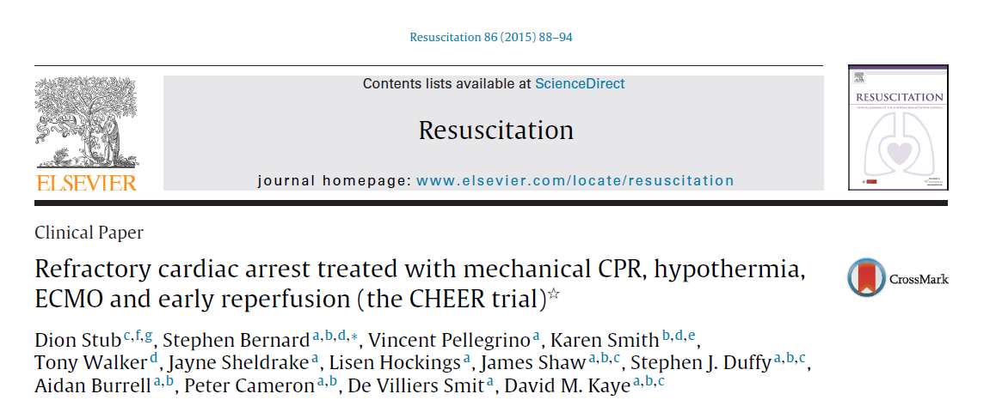
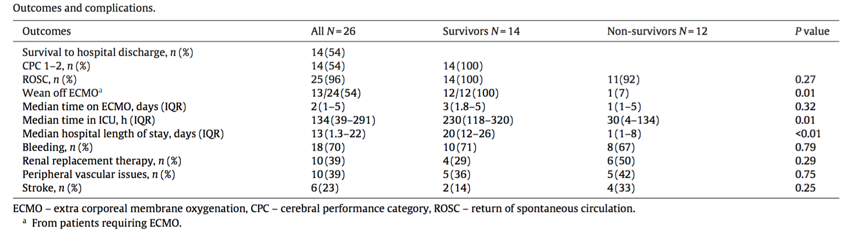
E-CPR
Hypothermia (33c), ECMO and early reperfusion.
CPR of more than 30 mins without ROSC
26 patients with cardiac arrest (11 OHCA+15 IHCA, with 73% had VF as initial rhythm).
Autopulse^{TM .}
ROSC -25/26 patients
The median time from collapse to institution of ECMO was 40 minutes in the 14 patients (3/9 OHCA and 9/15 of IHCA who received ECMO)
Survival with good neurological recovery (CPC 1-2) and survival to hospital- 14/26 (54%).
Resuscitation 86 (2015) 88–94

Slide 15
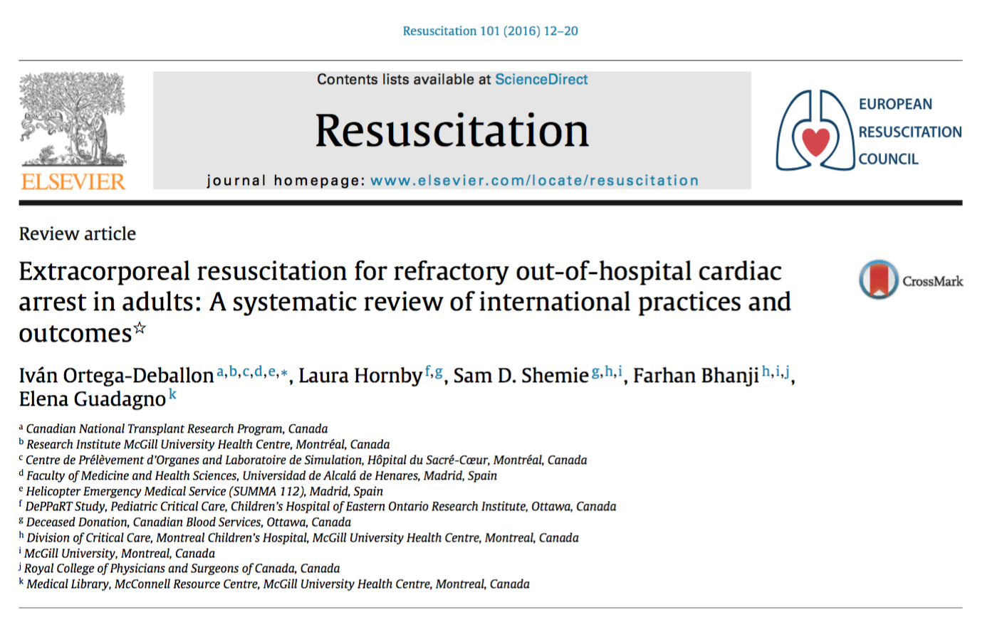
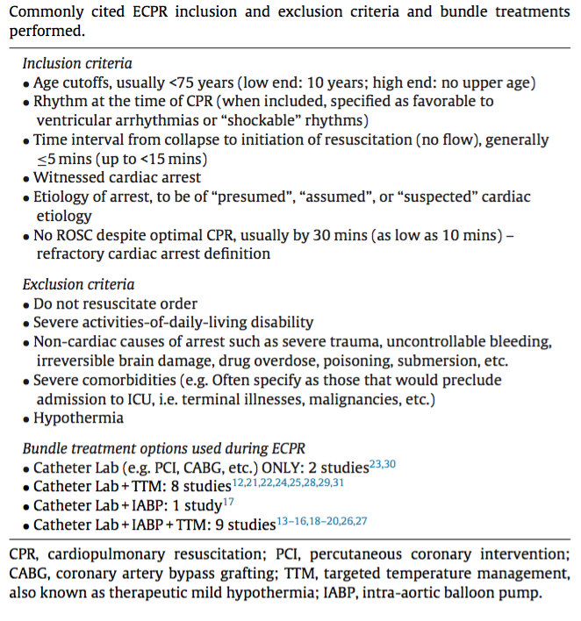
833 OHCA patients in 20 studies, with an overall survival rate of 22%, including 13% with good neurological recovery.
88 potential deceased donors (from 8 studies) 17 (19%) became actual donors: 15 DBD and 2 DCD.
Resuscitation 101 (2016) 12–20

Slide 16
ECMO in post cardiac surgery

Slide 17
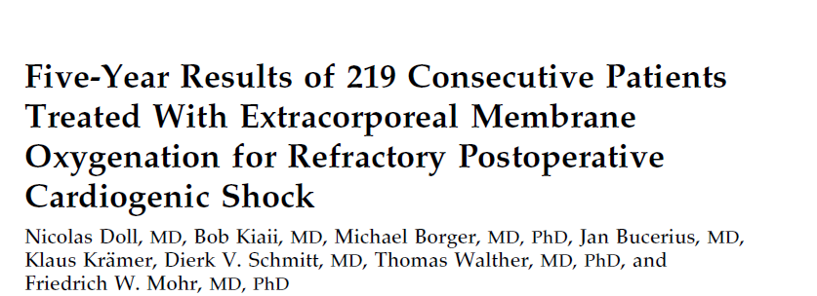
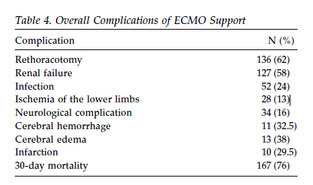
Temporary ECMO support in post cardiac Sx
A five-year prospective observational study
Post Cardiac surgery (CABG, CABG±AVR, CABG±MVR and some other cardiac Sx)
219 patients
Though 60% of the patients weaned successfully from ECMO but only 24% survived to hospital discharge
Main cause of death- Heart failure
After 5 years, 37 out of 52 patients who were discharged from hospital were alive with reasonable functional capacity.
Ann Thorac Surg 2004;77:151–7

Slide 18
ECMO in Pulmonary Embolism

Slide 19
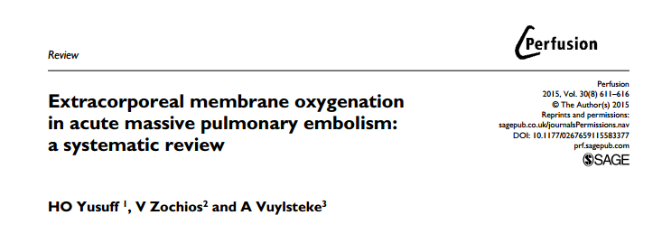
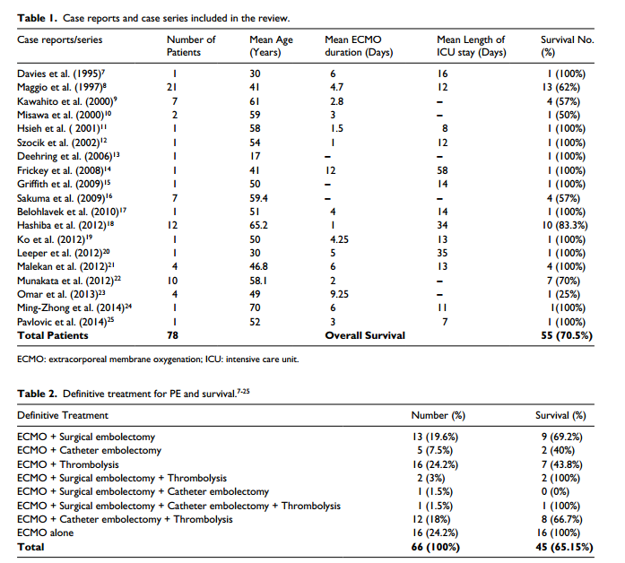
Massive PE & ECMO
They included 78 cases (11 case reports and 8 case series over a period of two decades)
Treatment modalities used-
ECMO alone
Combination of ECMO and thrombolysis, embolectomy (catheter or surgical)
43 patients (55.1%) were managed with ECMO along with the process of E-CPR (survival of 51.2% (22 patients)
Overall survival of 70.1%
16 patients who were treated with ECMO alone had a 100% survival alone without any additional therapy.
Perfusion 2015, Vol. 30(8) 611–616

Slide 20
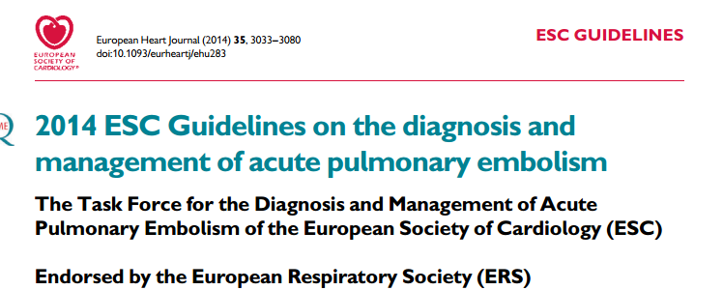
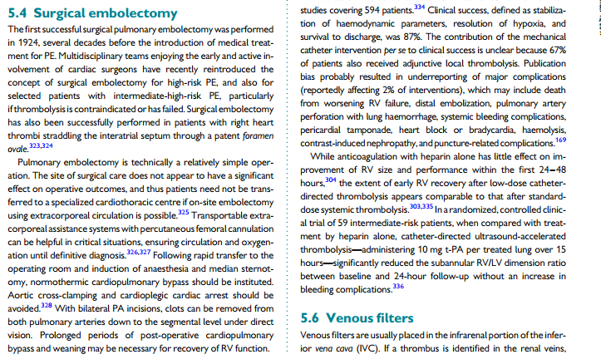
European Heart Journal (2014) 35, 3033–3080

Slide 21
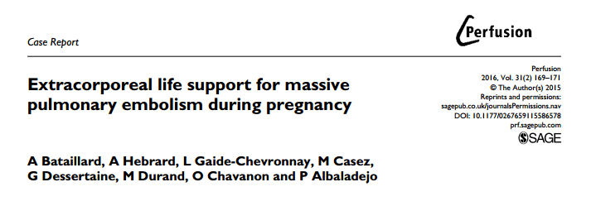
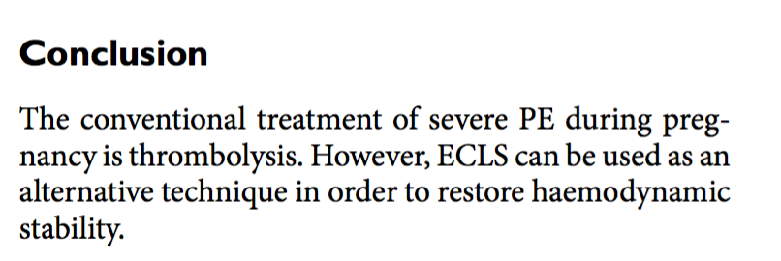
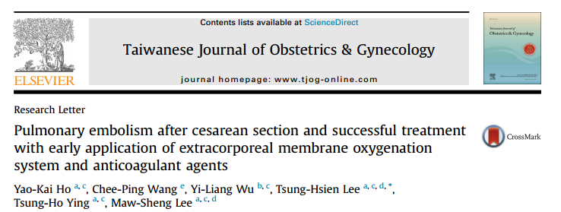
Pregnancy, massive PE, ECMO
Taiwanese Journal of Obstetrics & Gynecology 53 (2014) 273e275

Slide 22
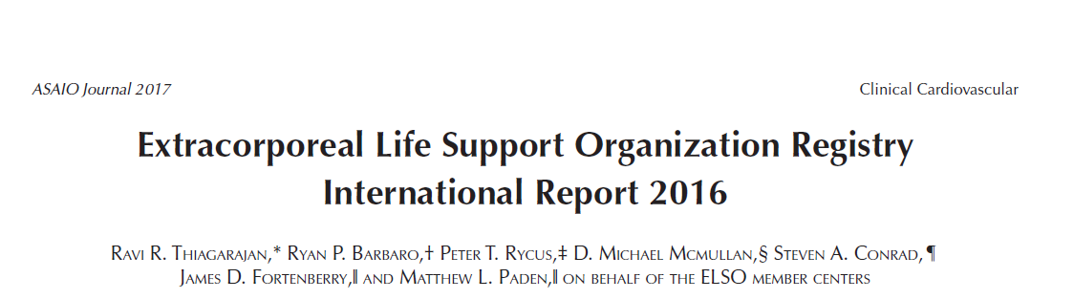
ELSO registry data
1988-2015- 8 reports- 78,397 adults+children
Overall 70% successful wean, 58% survival to hospital discharge
Adult respiratory ECLS (>18yrs)
Adult Cardiac ECLS (>16yrs)

Slide 23
ELSO centers

Slide 24
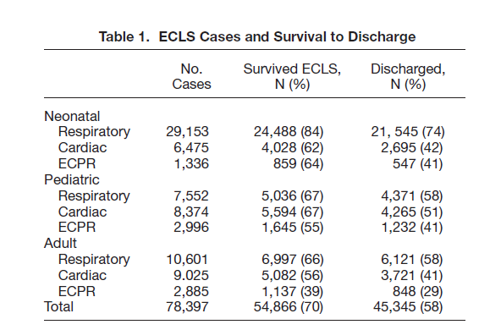
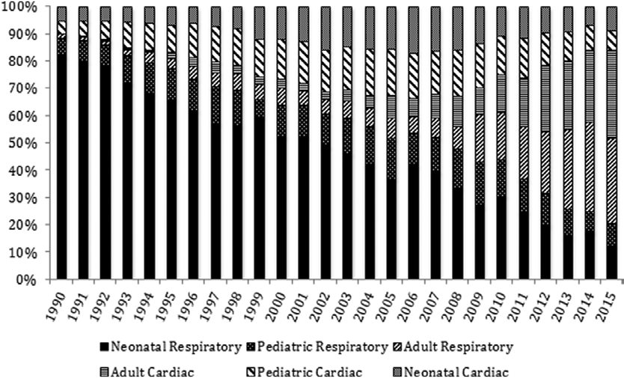
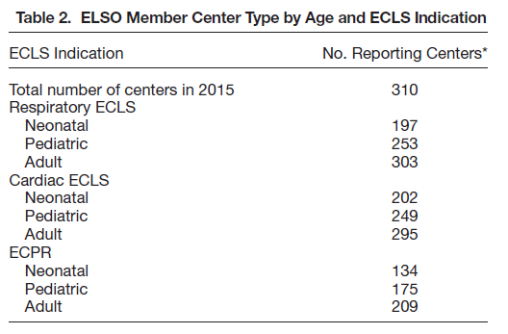

Slide 25
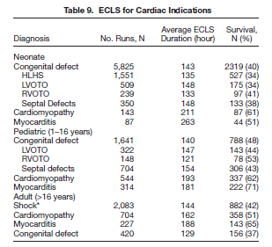
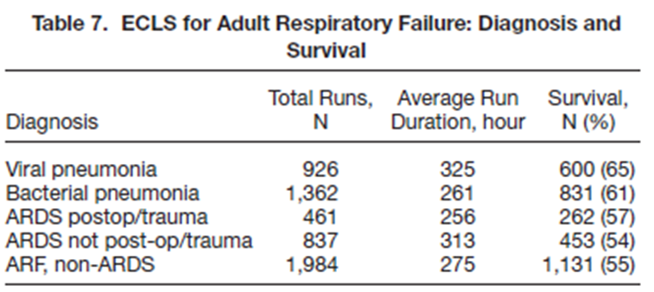


Slide 26
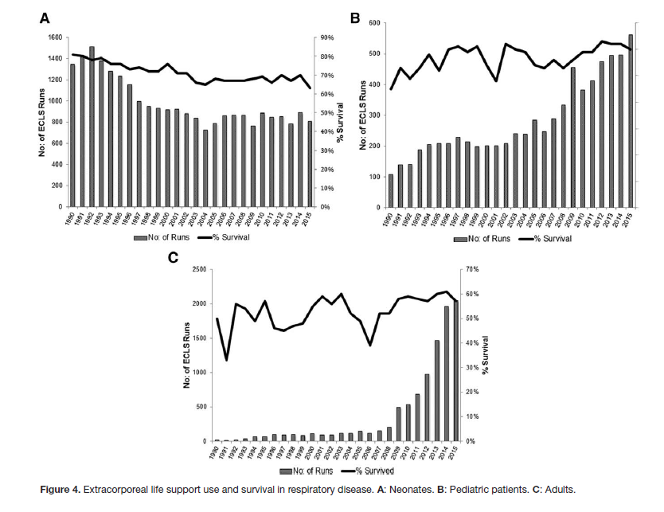

Slide 27
E-CPR
The registry contained 4,332 pediatric and 2,885 adults supported with ECPR with survival to discharge of 41% in pediatric and 29% in the adult groups.

Slide 28
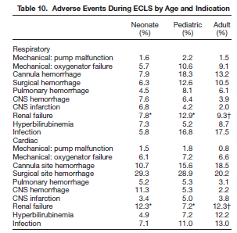
Adverse Events

Slide 29
Summary
ECMO is very effective in selected group of patients
Use will be more frequent in future
Ensure-
Correct patient selection
Correct expertise & team
Correct system in place

Slide 30
THANK YOU

