Slide 1
Post-cardiac arrest organ support & prognostication
Sananta Kumar Dash
MD (Anesthesiology), FNB (CCM), EDICM, FCCP

Slide 2
Systematic post–cardiac arrest care after return of spontaneous circulation (ROSC) can improve the likelihood of survival & good quality of life.^{1,2,3}
N Engl J Med. 2002;346:549 –556.
Bernard SA et al. N Engl J Med. 2002;346:557–563.
Neumar RW. Circulation. 2008;118:2452–2483.
.

Slide 3
Good post–cardiac arrest Care
Early
mortality
Late
Morbidity Mortality
Neumar RW. Circulation. 2008;118:2452–2483.
Safar P. Crit Care Med. 1988;16:923–941.

Slide 4
FACTORS THAT PREDICT OUTCOME OF A CARDIAC ARREST

Slide 5
Factors before Cardiac Arrest
Age
Ethnicity
Underlying dissease-Diabetes, cancer, infection, kidney disease and stroke

Slide 6
Factors during cardiac arrest
Time between collapse and start of CPR/defibrillation
Quality of CPR/defibrillation
Neurological function during or immediately after CPR

Slide 7
Factors after cardiac arrest and resuscitation:
Neurological function:
Poor function =>poor prognosis
Some patients suffer a stroke after a cardiac arrest.
Neurophysiologic function: Somatosensory evoked potentials (SSEP), Electroencephalogram (EEG).
Neuroimaging and monitoring: cranial CT, MRI, MR spectroscopy, PET.
Biochemistry: Blood/ CSF

Slide 8
MANAGEMENT OF POST CARDIAC ARREST PATIENT

Slide 9
Objectives
Optimize cardiopulmonary function and vital organ perfusion.
Out-of-hospital cardiac arrest
Transport patient to an appropriate hospital with a comprehensive post–cardiac arrest treatment system of care that includes acute coronary interventions,neurological care, goal-directed critical care, and hypothermia.

Slide 10
ROSC
Adult immedieate post cardiac arrest Care
Optimize ventitilation(SPO2>94 & Oxygenation, Advanced Airway & Capnography, No hyperventilation
Treat hypotension(IV/IO fluid, Vasopressors, Treat causes, 12 lead ECG)
NO
Induced Hypothermia
Follow Command?
YES
YES
Coronary reperfusion
STEMI or High suspicion AMI
NO
Advanced Critical Care

Slide 11
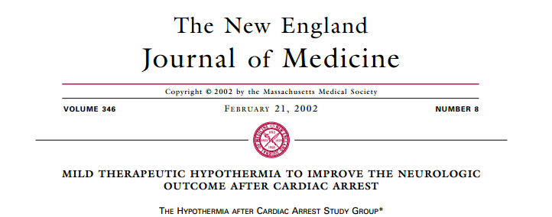
Improved neurologically intact survival to hospital discharge-- Comatose patients with out-of-hospital ventricular fibrillation (VF) cardiac arrest (Cooled to 32°C to 34°C for 12 or 24 hours).

Slide 12
Belliard G, Resuscitation. 2007;75:252–259. Castrejon S et al. Rev Esp Cardiol. 2009;62:733–741.
Targeted Temperature Management
Improved neurological outcome after therapeutic hypothermia for comatose survivors of VF cardiac arrest.(Historical controls).

Slide 13
Sunde K. Resuscitation. 2007;73:29 –39. Bernard SA. AnnEmerg Med. 1997;30:146 –153. Oddo M, Schaller. Crit Care Med. 2006;34:1865–1873. Busch M. Acta Anaesthesiol Scand. 2006;50:1277–1283.Storm. Crit Care. 2008;12:R78. Don CW Crit Care Med. 2009;37:3062–3069.
Hypothermia and normothermia for non-VF arrest-- No RCT as yet.
6 studies with historical control groups –Good outcome from use of therapeutic hypothermia in comatose survivors of out-of-hospital cardiac arrest associated with any arrest rhythm.

Slide 14
Timing for hypothermia
Not completely understood.
Studies of animal models of cardiac arrest showed that short-duration hypothermia (1 hour) achieved 10 to 20 minutes after ROSC had a beneficial effect that was lost when hypothermia was delayed.^{1,2,3}
Beyond the initial minutes of ROSC and when hypothermia is prolonged (12 hours), the relationship between the onset of hypothermia and the resulting neuroprotection is less clear.^{4,5}
Kuboyama K. Crit Care Med. 1993;21:1348 –1358.
Abella BS. Circulation. 2004;109:2786 –2791.
Takata K. Crit Care Med. 2005;33:1340 –1345.
Hicks SD. J Cereb Blood FlowMetab. 2000;20:520 –530.
Colbourne F. J Cereb Blood Flow Metab. 1999;19:742–749.

Slide 15
How & How long
A case series -- 49 consecutive comatose post– cardiac arrest patients cooled intravascularly after out-of hospital cardiac arrest.
Time to target temperature (median 6.8 hours)
But, this was not an independent predictor of neurological outcome.
The optimal duration of induced hypothermia is at least 12 hours and may be 24 hours.
Wolff B. Int J Cardiol. 2009;133:223–228.

Slide 16
Flint AC. Neurocrit Care. 2007;7:109 –118. Pichon N. Crit Care. 2007;11:R71. Kliegel A. Resuscitation. 2005;64:347–351. Kliegel A. Resuscitation. 2007;73:46 –53. Kim F. Circulation. 2005;112:715–719.
How…
Multiple methods for inducing hypothermia but no single method has proved to be optimal.
Feedback-controlled endovascular catheters and surface cooling devices are available.^{1,2,3}
Cooling blankets and frequent application of ice bags (are readily available, effective but more labor and closer monitoring)
Iced isotonic fluid can be infused.^{4.5}

Slide 17
Imamura M. Acta Anaesthesiol Scand. 1998;42:1222–1226. Pujol A. J Cardiothorac Vasc Anesth. 1996;10:336 –341.
Continuously monitor the patient’s core temperature .
Tools-using -Esophageal thermometer,
Bladder catheter (nonanuric patients)
Pulmonary artery catheter (placed for other indication)
Axillary and oral temperatures- Inadequate for measurement of coretemperature.
True tympanic temperature probes are rarely available and often unreliable.

Slide 18
Nielsen N. Acta Anaesthesiol Scand. 2009;53:926 –934. N Engl J Med. 2002;346:549 –556. Bernard SA. N Engl J Med. 2002;346:557–563.
Complications
Coagulopathy
Arrhythmias
Hyperglycemia¹ (Particularly with an unintended drop below target temperature)
Pneumonia and sepsis may increase.^{2,3}
Prolonged hypothermia is known to decrease immune function.

Slide 19
Comatose-- Lack of meaningful response to verbal commands
Recommendation
Pt’s cond. | ROCS | Inhospital | Out of Hospital | VF | Recommendation
Comatosed adult | YES | NO | YES | YES | Class I, LOE B
Comatosed adult | YES | YES | NO | ANY (PEA/Asystole) | Class IIb, LOE B
Comatosed adult | YES | NO | YES | ANY (PEA/Asystole) | Class IIb, LOE B
Active rewarming should be avoided in comatose patients who spontaneously develop a mild degree of hypothermia (32°C [89.6°F]) after resuscitation from cardiac arrest during the first 48 hours after ROSC. (Class III, LOE C).

Slide 20
Hyperthermia
Use of Antipyretic or cooling techniques for treating hyperthermia or maintaining “controlled normothermia” Vs no temperature intervention in post– cardiac arrest patients --There are no randomized controlled trials.

Slide 21
Wang Y. Stroke. 2000;31:404–409. Diringer MN. Crit Care Med. 2004;32: 559–564. Diringer MN. Crit Care Med. 2004;32:1489 –1495. Reith J. Lancet. 1996; 347(8999):422– 425. Hanchaiphiboolkul S.. J Med Assoc Thai. 2005;88:26 –31. Kammersgaard LP. The Copenhagen Stroke Study. Stroke. 2002;33:1759 –1762.
In patients with a cerebrovascular event leading to brain ischemia, studies demonstrate worsened short-term outcome and long-term mortality.

Slide 22
ORGAN SPECIFIC SUPPORT

Slide 23
Pulmonary System
Chest radiograph- Endotracheal tube position
Pulmonary infiltrates
Edema
Complications(chest compressions)
(rib fracture, pneumothorax, and pleural effusions)
Pneumonia.

Slide 24
Mechanical ventilatory support to reduce the work of breathing should be considered as long as the patient remains in shock.

Slide 25
The beneficial effect of high FIO2 on systemic oxygen delivery should be balanced with the deleterious effect of generating oxygen-derived free radicals during the reperfusion phase.

Slide 26
Kuisma M, Boyd J, Voipio V, Alaspaa A, Roine RO, Rosenberg P. Comparison of 30 and the 100% inspired oxygen concentrations during early post-resuscitation period: a randomised controlled pilot study. Resuscitation. 2006;69:199 –206.
Randomized prospective clinical trial .
Group 1- Ventilation (first 60 minutes after ROSC) with FiO2=0.30 (PaO2=110 mm Hg at 60 minutes) or
Group 2-Ventilation (first 60 minutes after ROSC) with FiO2=1 (PaO2=345 mm Hg at 60 minutes)
No difference in
serial markers of acute brain injury
survival to hospital discharge
percentage of patients with good neurological outcome at hospital discharge.

Slide 27
Hypercarbia
In a normal brain a 1-mm Hg decrease in PaCO2 results in a decrease in cerebral blood flow of approximately 2.5% to 4%.
Cerebral blood flow remains CO2-reactive after cardiac arrest.
Safar P.Stroke. 1996;27:105–113.
Kagstrom E. Acta Physiol Scand. 1983;118:281–291.

Slide 28
Wolfson SK. Resuscitation. 1992;23:1–20. Fischer M. Intensive Care Med. 1995;21:132–141.
After ROSC there is an initial hyperemic blood flow response that lasts 10 to 30 minutes, followed by a more prolonged period of low blood flow.

Slide 29
Sunde K.Resuscitation. 2007;73:29 –39.
Controlled ventilation with specific goals to keep PaCO2 37.6 to 45.1 mm Hg (5 to 6 kPa) and SaO2 95% to 98% as part of a bundle with multiple other goals (including hypothermia and blood pressure goals) increased survival from 26% to 56%.

Slide 30
Tidal Volume..
Historical comparison of ventilation practice after cardiac arrest reported no differences in pneumonia, oxygenation, lung compliance, and ventilator days when a low VT strategy versus a more liberal “old practice” VT was applied.
Wongsurakiat P. Chest. 2004;126:1281–1291.

Slide 31
Wan S.. Circulation. 2004;110: 744–749. Scholz KH. DtschMed Wochenschr. 1990;115:930 –935. Bottiger BW. Lancet. 2001;357(9268):1583–1585. Fatovich DM(The TICA trial). Resuscitation. 2004;61:309–313.
NO CPR AS YET ¹
FIBRINOLYTICS for
Cardiac Arrest due to PE
AFTER CPR ²
DURING CPR ^{3,4}
No additional Risk of any Bleed

Slide 32
Konstantinov IE. Tex Heart Inst J. 2007;34:41– 45;45–46. Fava M. J Vasc Interv Radiol. 2005;16:119 –123.
Surgical embolectomy has also been used successfully in some patients after PE-induced cardiac arrest.¹
Mechanical thrombectomy was employed in a small case series and only one of seven patients died and pulmonary perfusion was restored in the majority(85.7%).²

Slide 33
In post– cardiac arrest patients with arrest due topresumed or known pulmonary embolism, fibrinolytics may be considered (Class IIb, LOE C).

Slide 34
Sedation After Cardiac Arrest
If patient agitation is life-threatening, neuromuscular blocking agents can be used for short intervals with adequate sedation.
Minimizing sedation allows a better clinical estimate of neurological status, sedation, analgesia
Neuromuscular relaxation are routinely used to facilitate induced hypothermia and to control shivering.

Slide 35
Cardiovascular System
Evaluation of 12-lead ECG and cardiac markers after ROSC.
Aggressive treatment of ST-elevation myocardial infarction (STEMI) should begin as in non–cardiac arrest patients, regardless of coma or induced hypothermia.

Slide 36
Spaulding CM. N Engl J Med. 1997;336:1629 –1633. Sunde K.Resuscitation. 2007;73:29 –39. Reynolds JC. J Intensive Care Med. 2009;24:179 –186. Hovdenes J. Acta Anaesthesiol Scand. 2007;51:137–142.
PCI, alone or as part of a bundle of care, is associated with improved myocardial function¹ and neurological outcomes.^{2,3}
Therapeutic hypothermia can be safely combined with primary PCI after cardiac arrest caused by AMI.^{2,4}

Slide 37
Vasoactive Drugs for Use in Post–Cardiac Arrest Patients
Adrenergic drugs should not be mixed with sodium bicarbonate or other alkaline solutions in the IV line because there is evidence that adrenergic agents are inactivated in alkaline solutions.^{1,2}
Grillo JA. Crit Care Med. 1995;23:1061–1066.
Bonhomme L. Ann Emerg Med. 1990;19:1242–1244.

Slide 38
Spaulding CM. N Engl J Med. 1997;336:1629 –1633. Dumas F, Insights from the PROCAT(Parisian Region Out of Hospital Cardiac Arrest) Registry. Circ Cardiovasc Interv. 2010;3:200 –207.
Echocardiographic evaluation within the first 24 hours after arrest is a useful way to assess myocardial function in order to guide ongoing management.^{1,2}

Slide 39
Invasive monitoring
Mean arterial pressure 65 mm Hg and an ScvO2 70% are generally considered reasonable goals.

Slide 40
Glucose Control
Higher glucose levels with increased mortality or worse neurois . Intensive therapy leads to more frequent episodes of severe hypoglycemia. ^{1,2,3,4,5}
Target glycemic control (144 to 180 mg/dL [8 to 10 mmol/L]) may be considered in adult patients with ROSC after cardiac arrest (Class IIb, LOE B).
Skrifvars MB.Resuscitation. 2003;59:319 –328.
Langhelle A.Resuscitation. 2003;56:247–263.
Nolan JP. Anaesthesia. 2007;62:1207–1216.
Losert H. Resuscitation. 2008;76:214 –220.
Mullner M. J Cereb Blood Flow Metab. 1997;17:430–436.

Slide 41
Corticosteroid in Post Arrest
Post cardiac arrest may present as relative adrenal insufficiency compared with the metabolic demands of the body.^{1,2}
Relative adrenal insufficiency in the post– cardiac arrest phase was associated with higher rates of mortality.^{1,2,3}
At present there are no human randomized trials investigating corticosteroid use after ROSC.
Schultz CH. Crit Care Med. 1993;21:1339 –1347.
Kim JJ. Am J Emerg Med. 2006;24:684–688.
Pene F. Intensive Care Med. 2005;31:627– 633.

Slide 42
Central Nervous System
Brain injury is the cause of death in 68% of patients after out-of-hospital cardiac arrest and in 23% after in-hospital cardiac arrest.13
Laver S. Intensive Care Med. 2004;30:2126 –2128.

Slide 43
EEG
An EEG for the diagnosis of seizure should be performed with prompt interpretation as soon as possible and should be monitored frequently or continuously in comatose patients after ROSC (Class I , LOE C).

Slide 44
EEG
No electrophysiological study reliably predicts outcome in comatose patients during the first 24 hours after ROSC.
An EEG pattern showing generalized suppression to 20 V, burst-suppression pattern associated with generalized epileptic activity, or diffuse periodic complexes on a flat background is associated with a poor outcome.
Wijdicks EF .Report of the Quality Standards Subcommittee of the American Academy of Neurology. Neurology. 2006;67:203–210.

Slide 45
Anticonvulsant therapy
No studies have addressed whether anticonvulsant therapy improves outcome after cardiac arrest, and several studies demonstrated that post– cardiac arrest seizures were refractory to traditional anticonvulsant agents.^{1,2,3}
The same anticonvulsant regimens for the treatment of seizures used for status epilepticus caused by other etiologies may be considered after cardiac arrest. (Class IIb, LOE C).
Krumholz A. Neurology.1988;38:401– 405.
Wijdicks EF. Ann Neurol. 1994;35:239–243.
Hui AC. Eur Neurol. 2005;54:10 –13.

Slide 46
Damian MS, Ellenberg D, Gildemeister R, Lauermann J, Simonis G, Sauter W, Georgi C. Coenzyme Q10 combined with mild hypothermia after cardiac arrest: a preliminary study. Circulation. 2004;110: 3011–3016.
Thiopental, glucocorticoids, nimodipine, lidoflazine, diazepam, and magnesium sulfate- No neuroprotection (witout hypothermia) ¹
One trial using coenzyme Q10 in patients receiving hypothermia failed to show improved survival with good neurological outcome.²
The routine use of coenzyme Q10 in patients treated with hypothermia is uncertain (Class IIb, LOE B).

Slide 47
Prognostication of Neurological Outcome in Comatose Cardiac Arrest Survivors
Early prognostication of neurological outcome is an essential component of
post–cardiac arrest care.

Slide 48
After 24 hours somatosensor evokedpotentials (SSEPs) and select physical examination findings at specific time points after ROSC in the absence of confounders (such as hypotension, seizures, sedatives, or neuromuscular blockers) are the most reliable early predictors of poor outcome in patients not undergoing therapeutic hypothermia.

Slide 49
Measures of Prognosis
Clinical Signs
Electrophysiological Signs
Neuroimaging and Other Imaging
Biochemical Signs

Slide 50
Clinical Signs

Slide 51
Pupillary Reaction
Absence of a pupillary reaction to light suggests a poor prognosis but has unclear specificity (early after a cardiac arrest)
Berek K et al.Stroke 1995;26:543-9

Slide 52
152 absent pupillary response
On admission
0 to 31%
491 pts
False positive result
0 %
108 absent pupillary response
On 3rd day
Berek K et al.Stroke 1995;26:543-9

Slide 53
Response to noxious stimulus
Multicenter study
400 patients with cardiac arrest
Noxious stimuli that was no better than extensor posturing (i.e., a decerebrate response or no response)
No false positives for a poor outcome at 72 hrs.
Didn’t include pt. treated with hypothermia.

Slide 54
Corneal Reflex
In two prospective studies, the absence of a corneal reflex at 72 hours was associated with no false positives for a poor outcome (95% CI, 0 to 14 in one study and 0 to 41 in the other); this response was observed in approximately 13% of the patients.
Levy DE et al. JAMA 1985;253:1420-6.
Zandbergen EGet al. Neurology 2006;66:62-8.

Slide 55
Vestibulo-occular reflex
In one study, this response was absent in about 43% of patients, with no false positives for a poor outcome (95% CI, 0 to 41).
Caloric response can be blunted by sedative & narcotics.
Zandbergen EG et al. Neurology 2006;66:62-8.
Morrow SA et al. Neurocrit Care 2007;6:45-8.

Slide 56
Myoclonic status epilepticus
Prospective study
407 patients with myoclonic
Status epilepticus at 24 hours after arrest– poor outcome (no false positives (95% CI, 0 to 14).
Zandbergen EG et al. Neurology 2006;66:62-8.

Slide 57
Electrophysiological tests

Slide 58
Wijdicks EF.Report of the Quality Standards Subcommittee of the American Academy of Neurology. Neurology. 2006;67:203–210. Zandbergen EG. Lancet. 1998;352(9143):1808 –1812.
Evoked Potentials
Abnormalities in evoked potentials are associated with poor outcomes. Bilateral absence of the N20 cortical response to median nerve SSEPs predicts poor outcome (FPR 0%, 95% CI 0% to 3%).^{1,2}

Slide 59
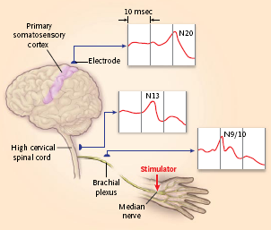
Bilateral absence of the N20 cortical response to median nerve stimulation after 24 hours predicts poor outcome in comatose cardiac arrest survivors not treated with therapeutic hypothermia (Class IIa, LOE A)
N20 response from the primary somatosensory cortex(assessed 20 msec after electrical stimulation of the median nerve)
If N20 is absent, there is no upward
deflection at 20±2 msec from the time of the stimulus.
N.B- To ensure that the
sensory pathway up to the brain is intact, responses from the brachial plexus
(N9) and the cervical spinal cord (N13) are also recorded.

Slide 60
Brain stem Auditory Evoked Potentials have been associated with poor outcomes in comatose cardiac arrest survivors but less reliable predictors of poor outcome than SSEPs.
Also have not been studied in enough patients to establish their reliability.

Slide 61
Neuroimaging

Slide 62
Neuroimaging
Extensive cortical and subcortical lesions on MRI are associated with poor neurological outcome.
Allen JS. J Clin Exp Neuropsychol.2006;28:457– 476.

Slide 63
Biochemical signs

Slide 64
CT parameters associated with poor outcome-
quantitative measure of gray matter:white
matter Hounsfield unit ratio and qualitative
description of brain structures.

Slide 65
Blood and Cerebrospinal Fluid Biomarkers
Biomarkers that are predictive of neurological outcome are typically released from dying neurons or glial cells in the brain (eg, neuron-specific enolase[NSE], S100B, GFAP, CK-BB)

Slide 66
Wijdicks EF .Report of the Quality Standards Subcommittee of the American Academy of Neurology. Neurology. 2006;67:203–210. Zandbergen EG. Neurology. 2006;66:62– 68.
The most promising and extensively studied biomarker is serum NSE.
Reported to have a 0% FPR (95% CI 0% to 3%) for predicting poor outcome when measured between 24 and 72 hours after cardiac arrest.^{1,2}

Slide 67
Grubb NR. Prediction of cognitive dysfunction after resuscitation from out-of-hospital cardiac arrest using serum neuron-specific enolase and protein S-100. Heart. 2007;93:1268 –1273.
primary limitation of serum NSE is the variability among studies in both the assays used and the cutoff value that results in an FPR of 0% for predicting poor.

Slide 68
Pelinka LE.Nonspecific increase of systemic neuron-specific enolase after trauma: clinical and experimental findings. Shock 2005;24:119 –123.
Abdominal organ injury, have been associated with elevated NSE levels independent of cardiac arrest.

Slide 69
Changes in Prognostication With Hypothermia
There is a paucity of data about the utility of physical examination, EEG, and evoked potentials in patients who have been treated with induced hypothermia.
Durations of observation greater than 72 hours after ROSC should be considered before predicting poor outcome in patients treated with hypothermia (Class I, Level C).

Slide 70
Durations of observation greater than 72 hours after ROSC should be considered before predicting poor outcome in patients treated with hypothermia (Class I, Level C).

Slide 71
Guide Lines

Slide 72
COMA
Decision Algorithm for Use in Outcome Prediction for Comatose
Survivors of Cardiac Arrest
EXCLUDE MAJOR CONFOUNDERS
YES
BRAIN DEATH TEST
NO BRAINSTEM REFLEX AT ANY TIME
OR
FPR 0%
(0-8.8)
MYOCLONUS D1
YES
POOR OUTCOME
FPR 0%
(0-0.3.7)
OR
POOR OUTCOME
N 20 ABSENT
(D1-3)
YES
FPR0%(0-3)
OR
YES
POOR OUTCOME
SERUM NSE>33 MCG/LIT (D1-3)
FPR 0%
(0-3)
OR
BRAIN DEATH TEST
NO CORLEAL/PUPILLARYREFLEX/MOTOR RESPONSE EXCEPT EXTENSOR
YES
Wijdicks EFM et al. Neurology 2006; 67:203-10. al.

Slide 73
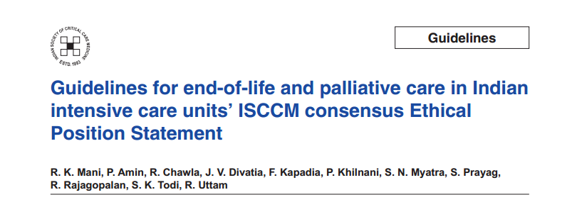

Slide 74
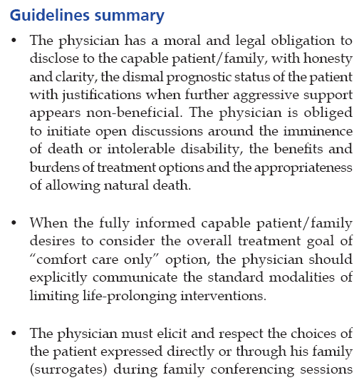
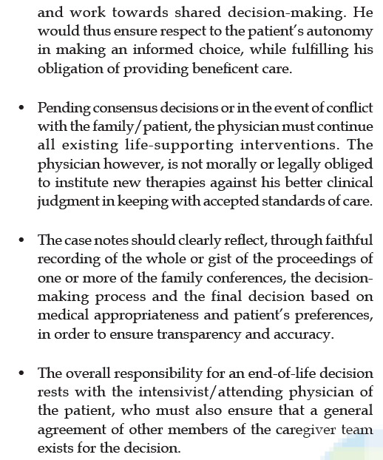

Slide 75
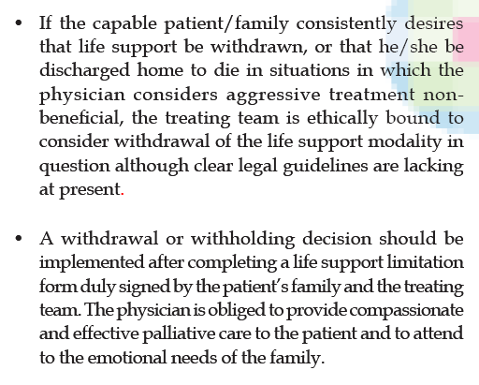

Slide 76
THANK YOU

