Slide 1
Management of Cardiac arrest in Post Cardiac Surgery
Sananta Kumar Dash
MD (Anesthesiology), FNB (CCM), EDICM, FCCP

Slide 2
Incidence
0.7-2.9 % (Survival 17-79%)

Slide 3
History
1864- John Hill Royal free Hospital- Sternal compression in 2 patients (arrested) revived.
1874- Hake et al. -1st description of open chest resuscitaion
1981- Fairman et al. – 1st to recommend emergency rethoracotomy in the intensive care unit after a cardiac surgery operation

Slide 4
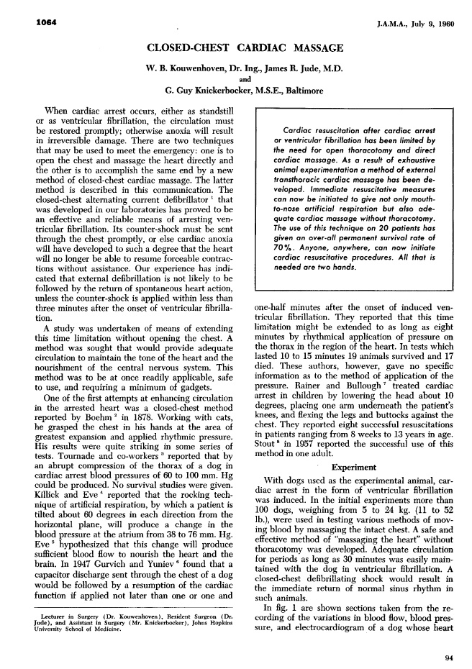
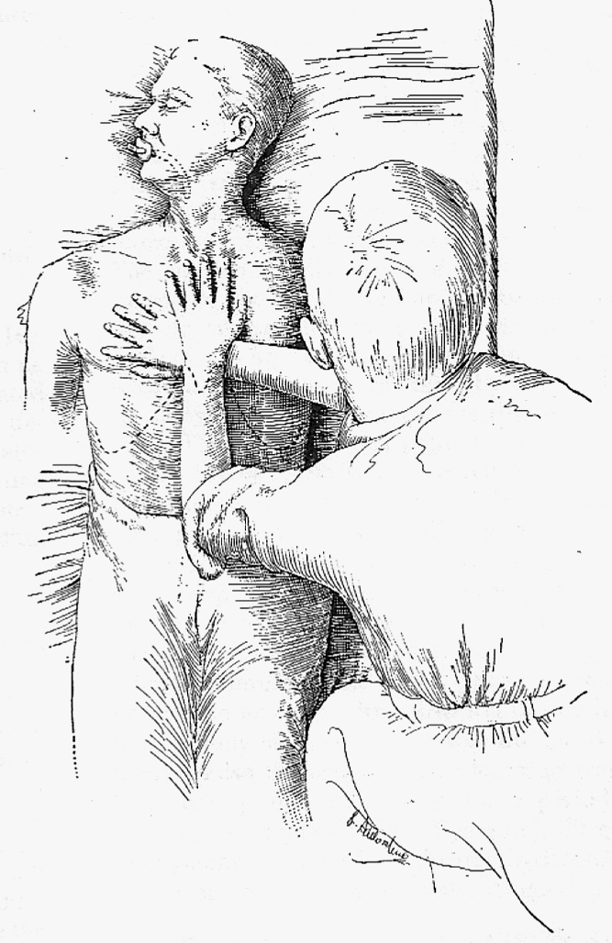
Kourwenhoven WB et al, JAMA, 1960.

Slide 5
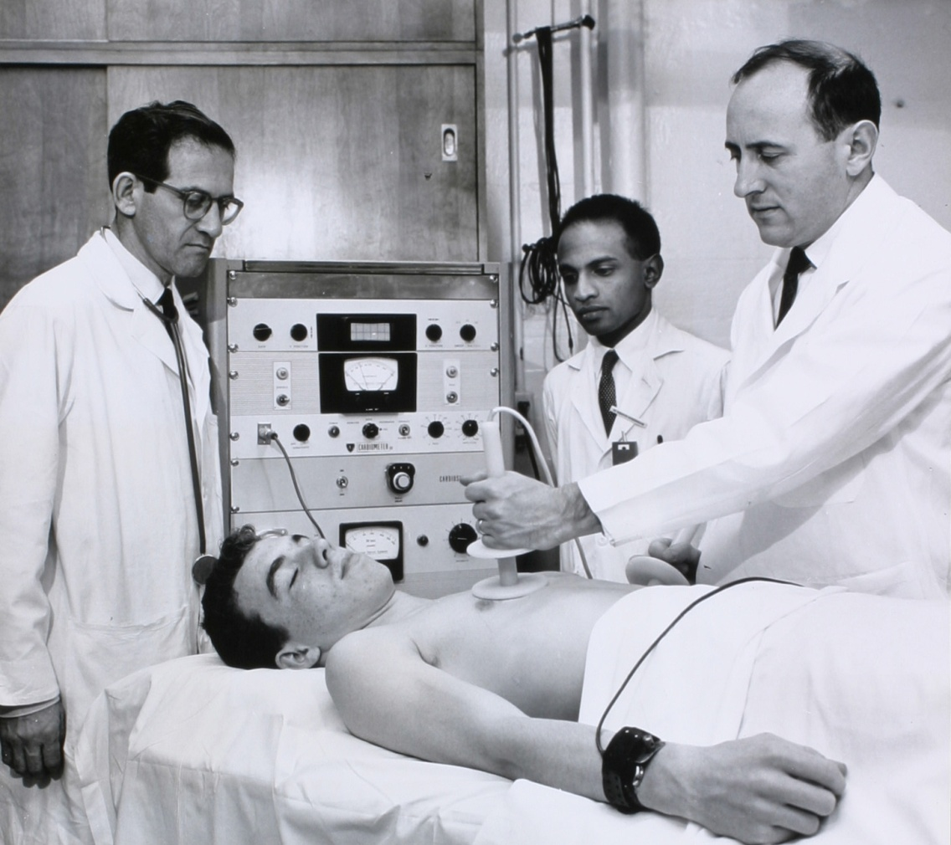
Bernard Lown introduced the first direct current (DC) defibrillator.
The Lown waveform was the standard for defibrillation until the change to biphasic defibrillation which started in the late 1980s.

Slide 7
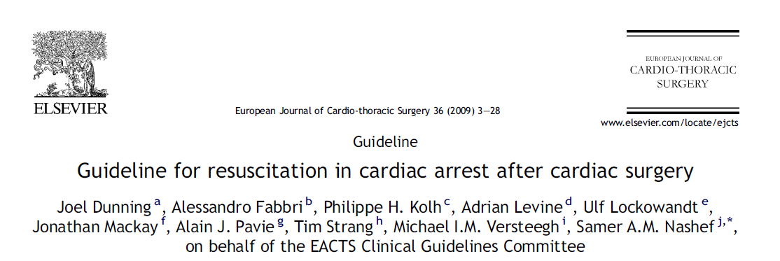
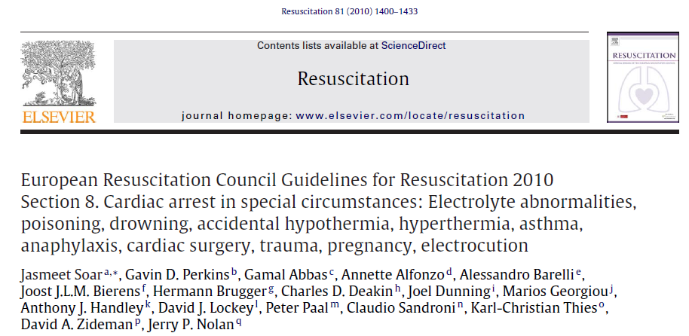
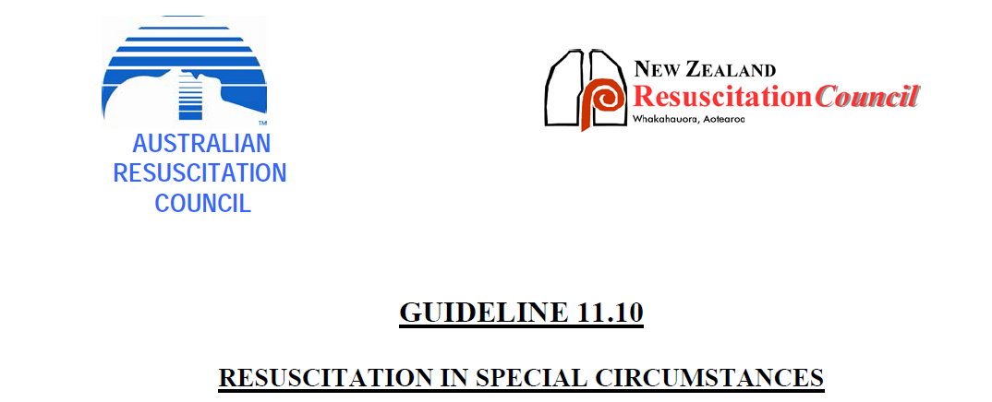
GUIDELINES
European Association for Cardio-Thoracic Surgery
European Resuscitation Council Guidelines
AHA

Slide 8
Identification of arrest and initiation of basic life support in the ICU
If the ECG shows VF or asystole, call cardiac arrest immediately.
If the ECG is compatible with a cardiac output, feel for a central pulse for 10 s and look at the pressure traces.
If arterial and other pressure waveforms are pulseless then call cardiac arrest immediately.
ECG trace looking like sinus rhythm in the absence of pulsatile traces from the other monitoring should be considered a cardiac arrest
Shout for help, for example: ‘cardiac arrest bed 4!’

Slide 9
Start CPR
Consider reversible causes
Hypoxia- tube position, 100% O2
Tension pneumothorax- Clinical exam, thoracic USG
Hypovolumia
Pacing failure- Chest compression can be momentarily delayed if pacing can be reestablished rapidly(DDD at 100/min with maximum amplitude)
Cardiac tamponade – Clinical- Beck’s triad↑ JVP, Loss of Y descend on CVP trace,
MI
Haemorrhage
Dyselectrolytemia
VF/VT accounts for 25-50% cases

Slide 10
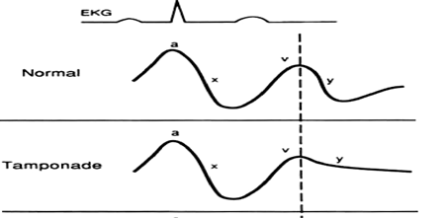
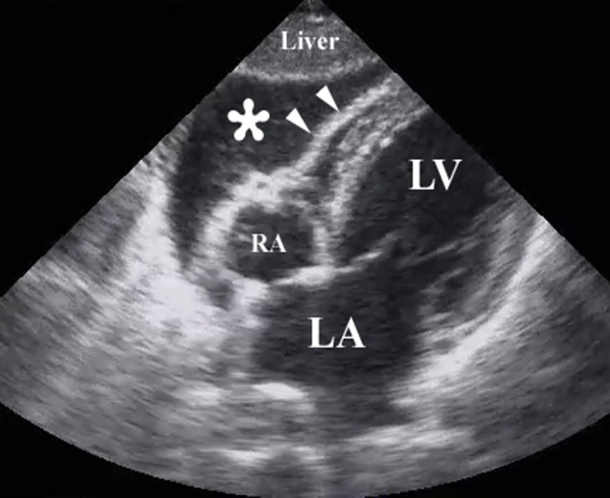
Cardiac tamponade
↑JVP, Loss of Y descend, sharp & deep x descend in CVP
JVP
↓BP
BECK’s triad
Muffled Heart Sound
Pulsus paradoxus

Slide 11
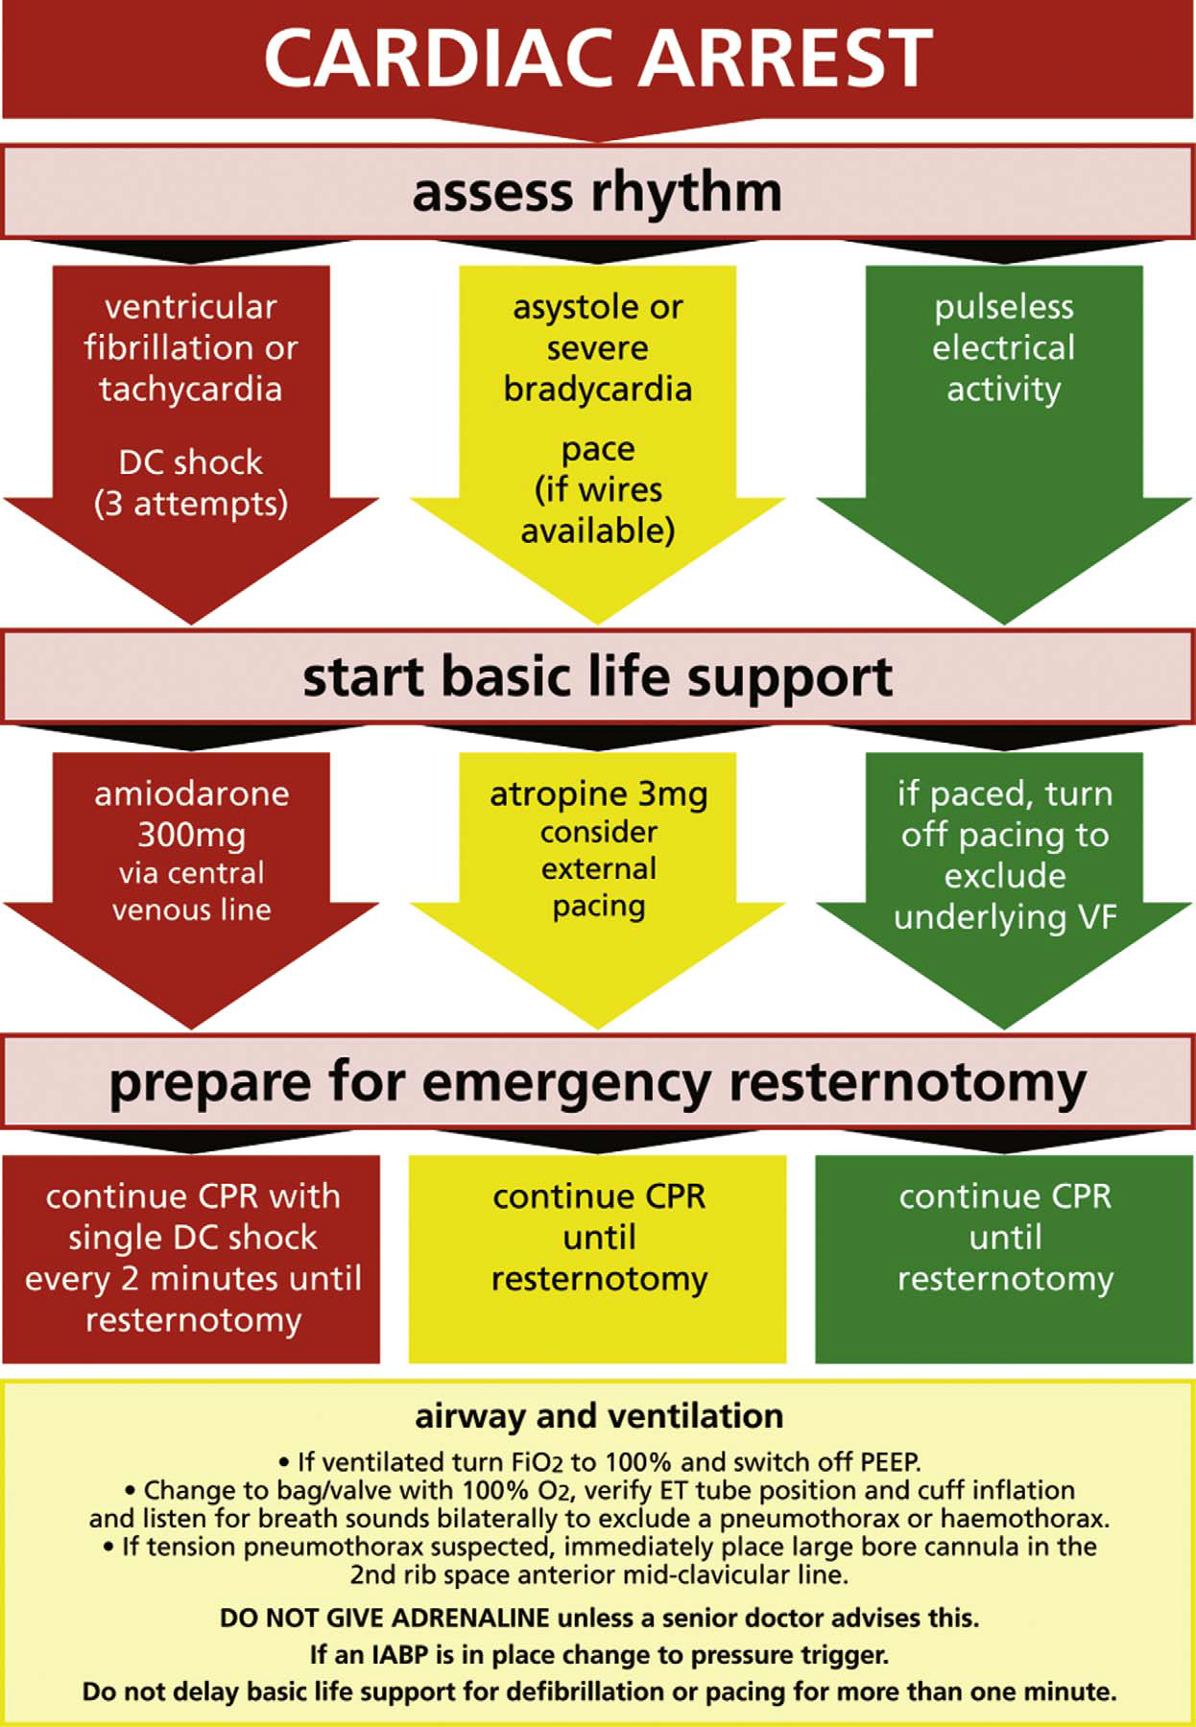
European Journal of Cardio-thoracic Surgery 36 (2009) 3—28

Slide 12
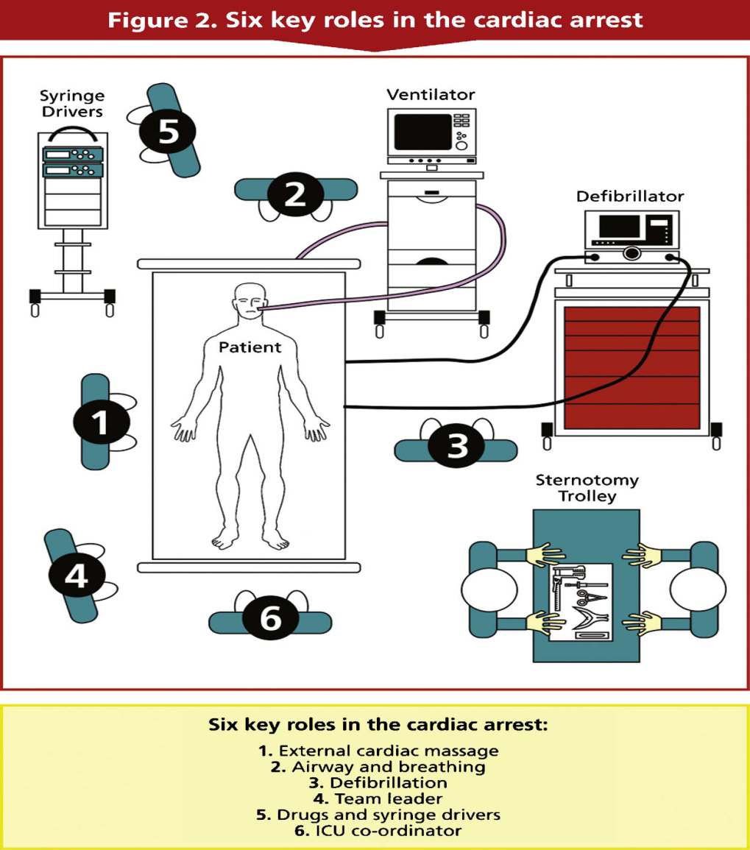

Slide 13
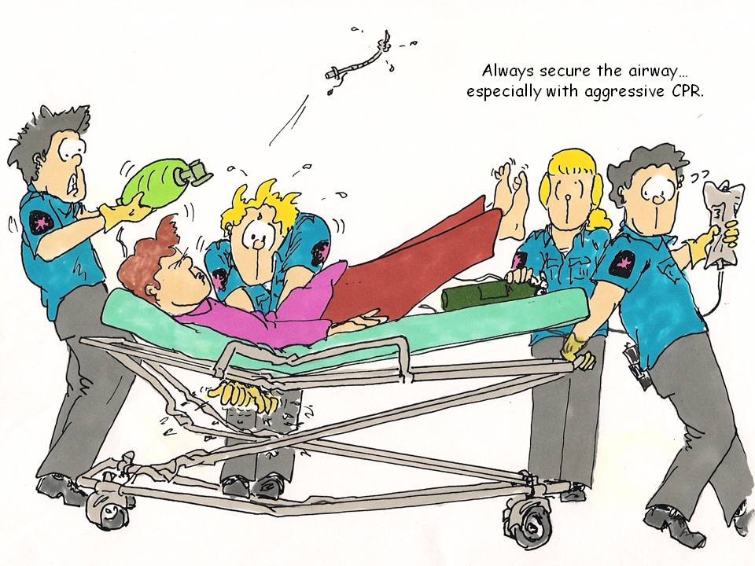
Airway and breathing
Oxygen 100%.
Ventilator disconnected and a bag/valve used.
Listen for breath sounds both sides to identify a pneumothorax or a haemothorax if present.
If Tension pneumothorax – drain (needle followed by drain)

Slide 14
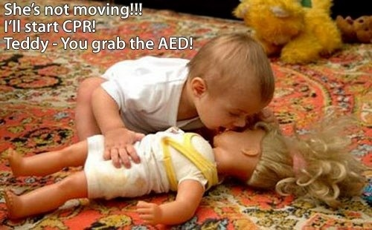
Chest compression
ECM should commence immediately at a rate of 100 beats/min while looking at the arterial trace to assess effectiveness.
Can be deferred until initial defibrillation or pacing (as appropriate) have been attempted, provided this can be done in less than 1 min.

Slide 15
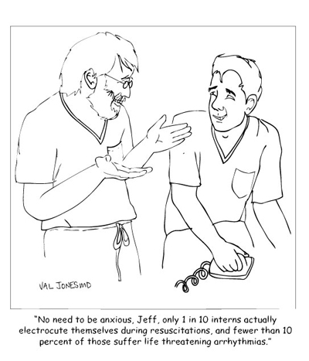
Defibrillation
VF/VT (monitored)- Immediate upto three stalked shocks
If unsuccessful- trigger the need for resternotomy
Further defibrillation as per algorithm
Defibrillation with internal paddles (10-20 J) once open chest.

Slide 16
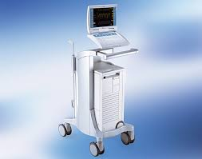
patients with an intra-aortic balloon pump
Set to pressure trigger.
If there is a significant period without massage, triggerings should be changed to internal at a rate of 100 bpm until massage is recommenced.

Slide 17
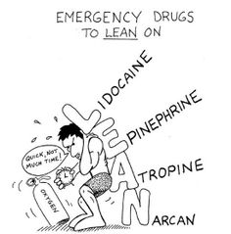
Emergency drugs
Adrenaline/Vasopressin- Shouldn’t be given during the cardiac arrest unless directed by a senior clinician experienced in their use. (insufficient evidence)
Dose- ≤ 100 mcg
Stop all drug infusion and check all of them are correct to exclude medication errors
Atropine- Not recommended routinely unless patient falls in bradycardia algorithm
Amiodarone- 300 mg after third failed defibrillation

Slide 18
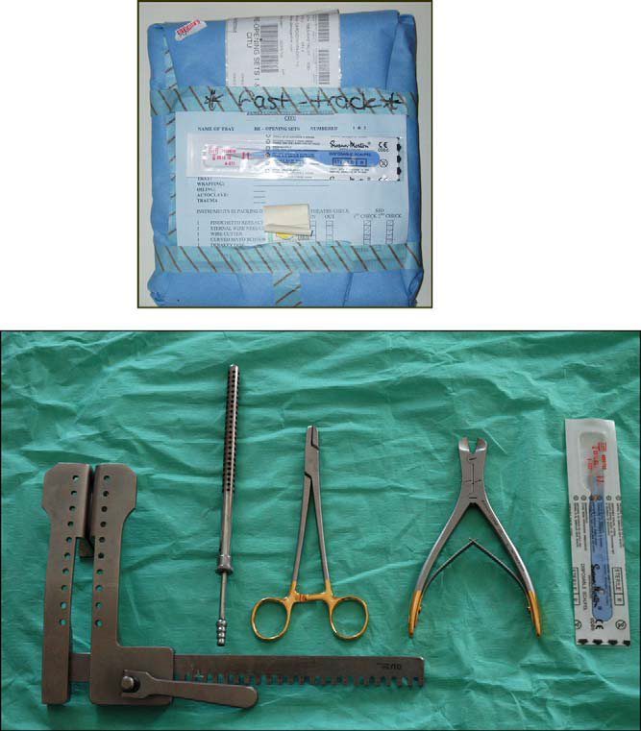
Re-thoracotomy indications
Rethoracotomy
Performed by intensive care specialist.
Dedicated set of surgical instruments

Slide 19
Emergency resternotomy
All reversible causes excluded
Resternotomy if
Failed 3 attempts of defibrillation
Adequate airway & ventilation achieved
Asystole/PEA when other treatments failed
Perform safely within 5 mins of arrest
Should be standard part of resuscitation within 10days of cardiac Sx
Internal cardiac massage(Survival to discharge 17-25%)

Slide 20
Reinstitution of emergency CPB
Survival to discharge- 32-56% (when CPB instituted in ICU)
Indications
Correct Sx bleeding
Graft occlusion
Rest to myocardium

Slide 21
Difference
 | Post cardiac Surgery CPR | Conventional CPR
Adrenaline | ≤100 mcg | 1000mcg
Chest compression | Can wait if defibrillation is immediately available Pacing can be started immediately Internal massage if chest is open | Chest compression 1st priority
Shock | 3 stalked shock, internal paddle (10-20 J if open chest) | Single shock
Pacing | Start when indicated | Not indicated in asystole
Resternotomy | High priority if reversible causes exclude | NA

Slide 22
Unresolved issues
Precordial thump
Administration of Adrenaline/ Vasopressin

Slide 23
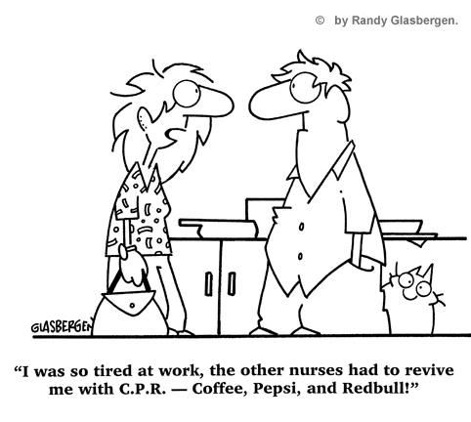
Thank you

