Slide 1
Takotsubo cardiomyopathy
Sananta Kumar Dash
MD (Anesthesiology), FNB (CCM), EDICM, FCCP

Slide 2
Takotsubo cardiomyopathy
transient apical ballooning syndrome
apical ballooning cardiomyopathy
stress-induced cardiomyopathy
Gebrochenes-Herz-Syndrom
stress cardiomyopathy
broken-heart syndrome

Slide 4
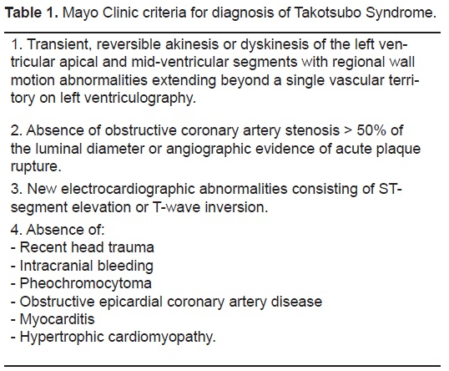

Slide 5
Epidemiology
female-to-male ratio, 9:1 (in japan male>female)

Slide 6
trigger
Emotional
Physical
Both
None
> half of patients have acute, former, or chronic neurologic or psychiatric disorder.

Slide 7
Clinical features
chest pain and dyspnea (resembling acute myocardial infarction) Moreover
ECG findings- ST elevation in precordial leads
Subsequent T-wave inversion and Q-wave

Slide 8
diagnosis

Slide 9
Pathophysiology
Catecholamine Cardiotoxicity
both epinephrine and norepinephrine ⬆ (circulating epinephrine exerts far more potent hormonal effects on the heart than norepinephrine )
trigger a switch in cardiomyocyte intracellular signaliing after occupation of ℬ2-adrenoceptors from Gs (stimulatory) protein to Gi (inhibitory) protein coupling.

Slide 10
Pathophysiology
Neurogenic Stunned Myocardium
basal myocardium has a somewhat higher norepinephrine content and greater density of sympathetic nerves than the apical myocardium, however, the left ventricular apex contains a higher concentration of adrenoceptors. Thus, myocardial responsiveness to adrenergic stimulation is pronounced in the apex .
the density of β-adrenoceptors in the apical myocardium is increased to compensate for the decrease in direct sympathetic innervation, to maintain a balanced responsiveness of the ventricle to sympathetic drive.
decreased inotropic responses to norepinephrine in the setting of catecholamine-induced cardiomyopathy

Slide 11
Pathophysiology
norepinephrine - ℬ1-adrenoceptors
positive inotropic and lusitropic responses (ℬ1 – GS- CAMP- PKA- increased contractile response
Epinephrine - ℬ1-adrenoceptors- Same as norepinephrine
has a higher affinity for the ℬ2-adrenoceptor
Humans- ℬ1:ℬ2 = 4:1
stimulus trafficking- At higher 'supraphysiological' concentrations- epinephrine stimulates ( a negative inotropic effect on myocyte contraction (switch in ℬ2 coupling, from Gs protein signaling to Gi protein signaling- produce a negative inotropic effect on human ventricular myocytes

Slide 12
Pathophysiology
Greater density of SNS nerves
Higher NAd content
Higher conc of adrenoceptors
Down regulation of adrenoceptors due to excess catecholamines (Gs - Gi)
Apical balooning & basal constriction band

Slide 13
Estrogen receptors (ER alfa and ERℬ) are expressed widely in the cardiovascular and central nervous systems.
reduced estrogen levels after menopause explain the predisposition of elderly women to takotsubo cardiomyopathy.

Slide 14
Relative estrogen deficiency
estrogen ⬇ levels - vulnerability to stress
estrogen supplementation-
⬇ sympathoadrenal activation and vagal inhibition which is observed in takotsubo cardiomyopathy
⬆atrial natriuretic peptide and heat shock protein 70 (cardioprotective substances)
⬇ expression of C-FOS and thereby have protective effects at the level of the target organs (Emotional stress- ⬆ expression of immediate early genes in the brain (C-FOS)

Slide 15
The estrogen hypothesis alone does not seem sufficient to explain the occurrence—albeit uncommon—of takotsubo cardiomyopathy in men.

Slide 16
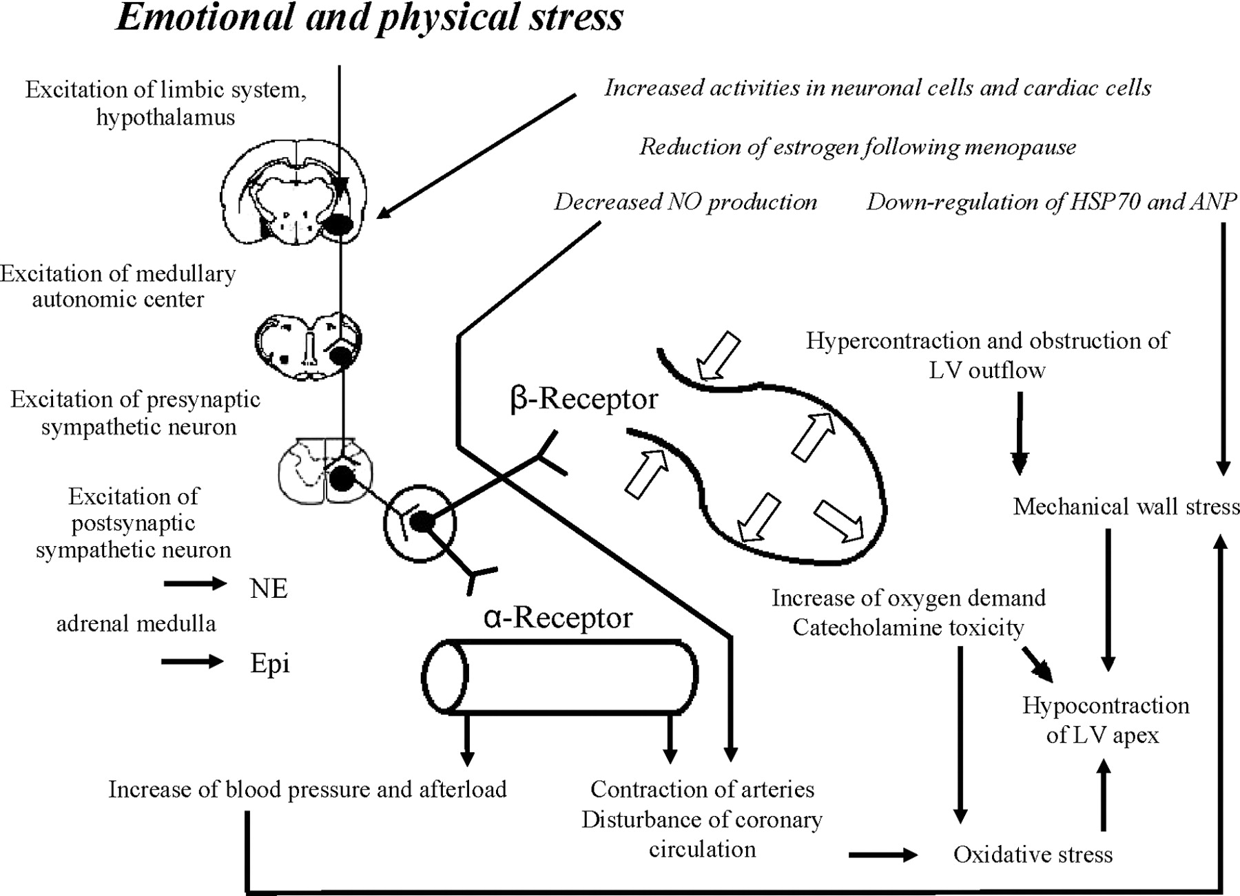
Pathophysiology - summary

Slide 17
Pathophysiology
Multivessel Epicardial Coronary Artery Spasm
spontaneous or inducible coronary arterial spasm has not been found in most cases of takotsubo cardiomyop- athy.
myocardial stunning resulting from epicardial coronary artery spasm does not seem to cause takotsubo cardiomyopathy.

Slide 18
Pathophysiology
Coronary Microvascular Impairment
It may accompany takotsubo cardiomyopathy; but, does not imply a cause-and-effect relationship. For
the microcirculatory abnormalities result from increased mechanical wall stress as a consequence of apical ballooning.

Slide 19
Complications & prognosis
Lv free wall ruture
Heart failure- pulmonary edema
Vt
Ventricular thrombus
Recurrence- 1.8%/patient year
Death- (5.6%/patient year)
Stroke/tia (1.7%/ patient year)

Slide 20
treatment
Use of ace inhibitors/arb- improved survival
Not ℬ blockers (no role in t/t or prevention for further episode)

Slide 22
question
To understand
The natural history
management
outcome of takotsubo (stress)
Comparison of Takotsubo Cardiomyopathy and Acute Coronary Syndrome

Slide 23
method
The International Takotsubo Registry (www .takotsubo-registry.com)
established at University Hospital Zurich in collaboration with 25 cardiovascularcentersacross 9 countries(Austria, Finland, France, Germany, Italy, Poland, Switzer- land, the United Kingdom, and the United States)

Slide 24
Groups- compared a subgroup of 455 patients in whom takotsubo cardiomyopathy had been diagnosed with 455 age- and sex-matched patients with an acute coronary syndrome

Slide 26
Inclusion criteria
Mayo clinic diagnostic criteria

Slide 27
outcome
iIn hospital complications
catecholamine use
cardiogenic shock
the use of invasive or noninvasive ventilation
cardiopulmonary resuscitation
death from any cause
Follow-up analysis
death from any cause
major adverse cardiac
cerebrovascular events
a composite of a recurrence of takotsubo cardiomyopathy
myocardial infarction
stroke
transient ischemic attack
death from any cause)

Slide 29
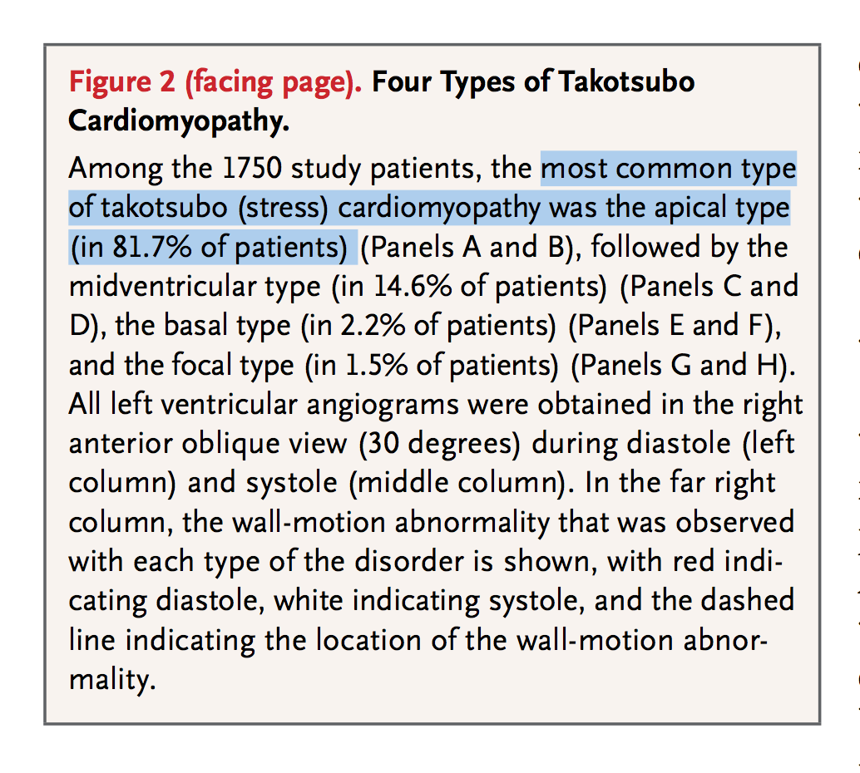
diagnosis

Slide 30
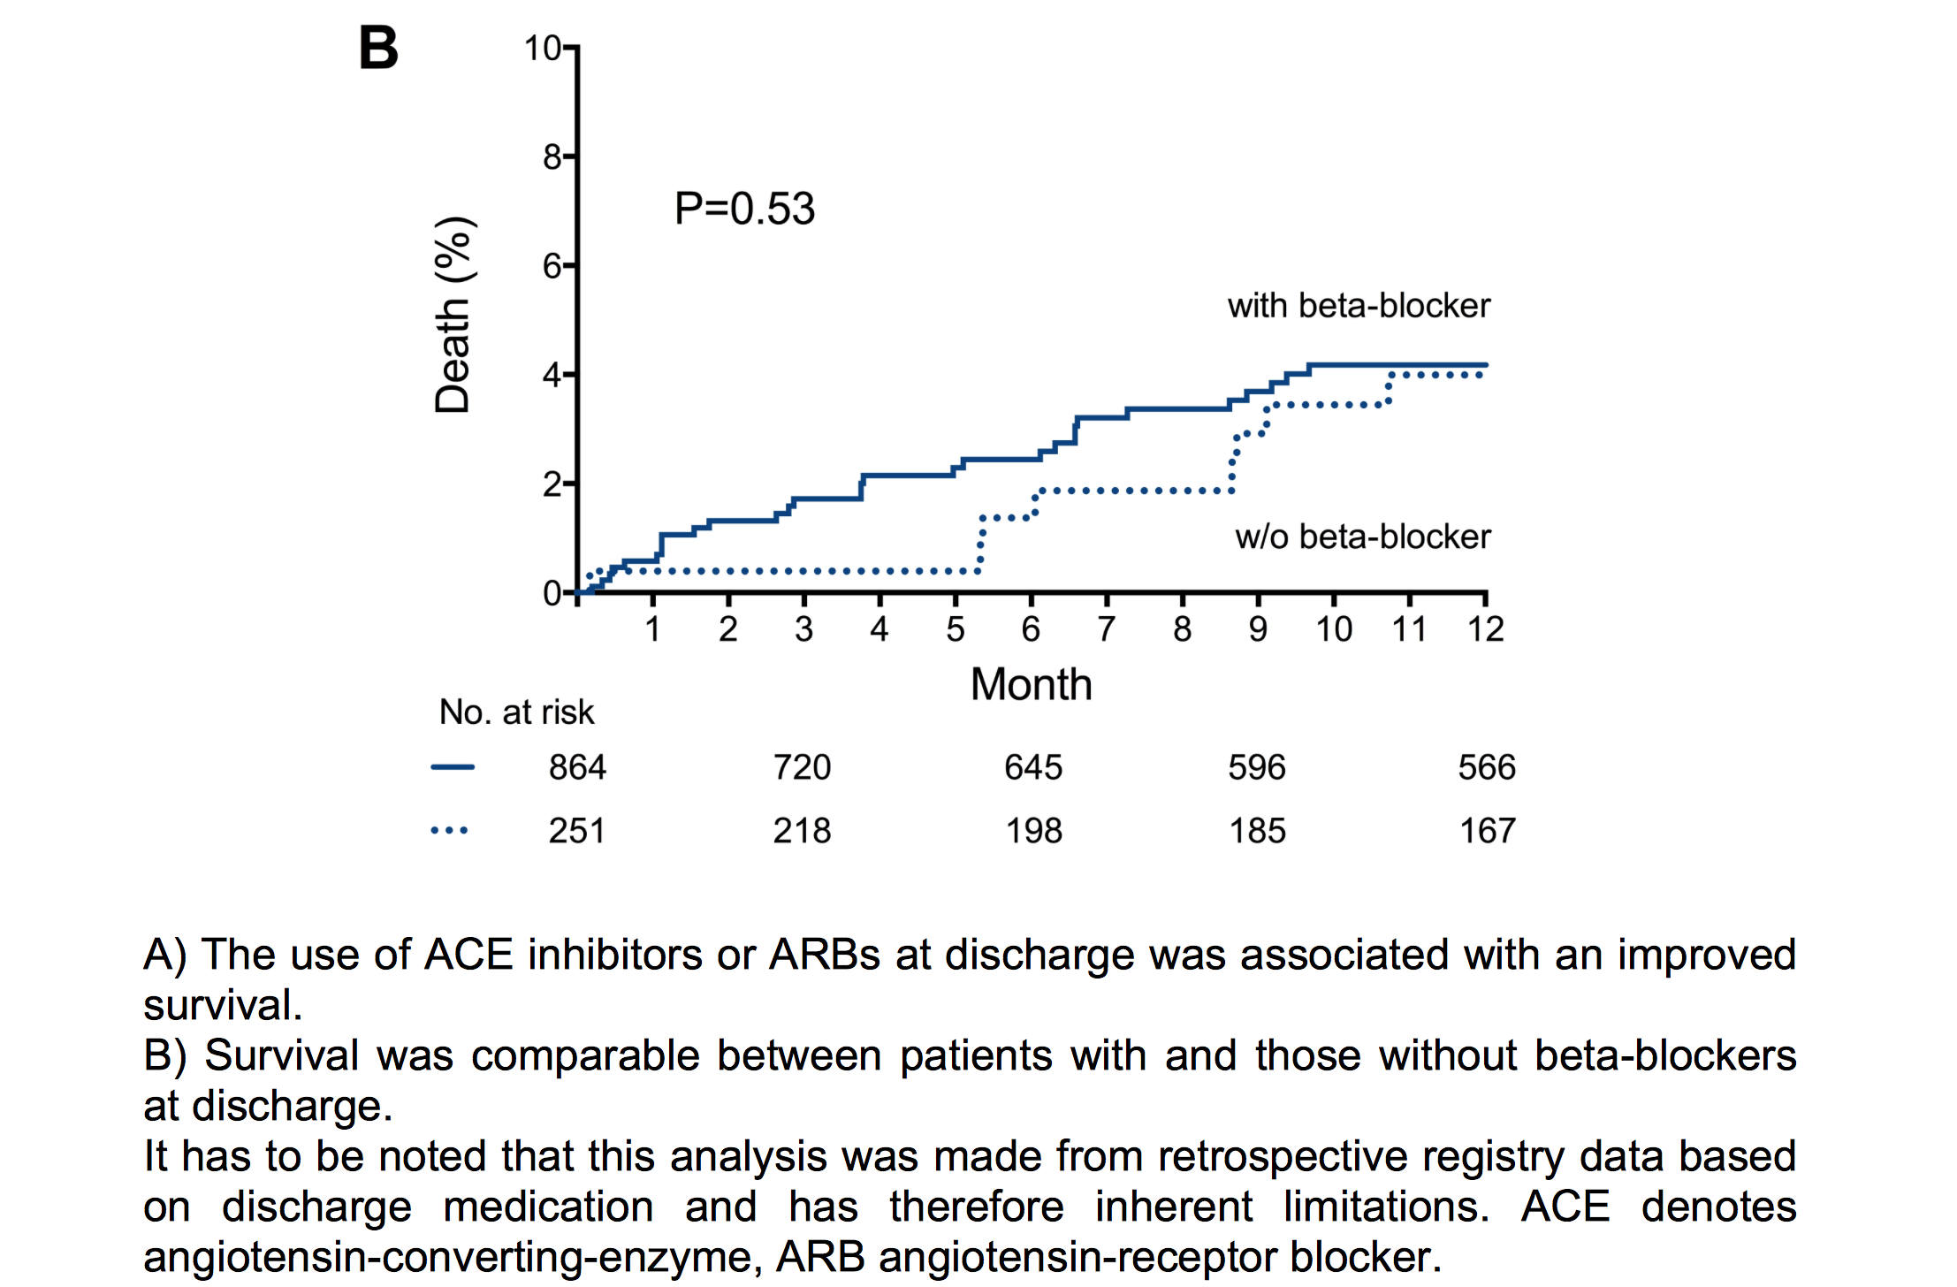

Slide 31
conclusion
Risk factors for complications
younger patients with physical triggers and acute neuro- logic or psychiatric diseases had an increased incidence of acute complications.
elderly patients with emotional triggers were at lower risk.
Ace inhibitors/arb at discharge have improved survival compared to ℬ blockers.

