Slide 2
acute severe asthma in icu :- Mechanical ventilation & other treatment modalities
Sananta Kumar Dash
MD (Anesthesiology), FNB (CCM), EDICM, FCCP

Slide 3
Content..
Definition of Severe Asthma.
Special points – Pathological changes affecting ventilatory strategy in Asthma.
Initial ventilator settings.
Other treatment modalities for severe asthma/Status asthmaticus

Slide 4
Continuing Education in Anaesthesia, Critical Care & Pain j. 2008

Slide 5
SPECIAL CHALLENGES
Inspiration
Work done to overcome Elastic forces (area 0AECD0; unhatched- Potential energy)
Work done to overcome Tissue resistance forces- Lost as heat
(area ABCEA; hatched)
Expiration
The Potential energy stored in inspiration is used in expiration (passive process)- released to overcome resistive forces+ remaining as heat lost

Slide 6
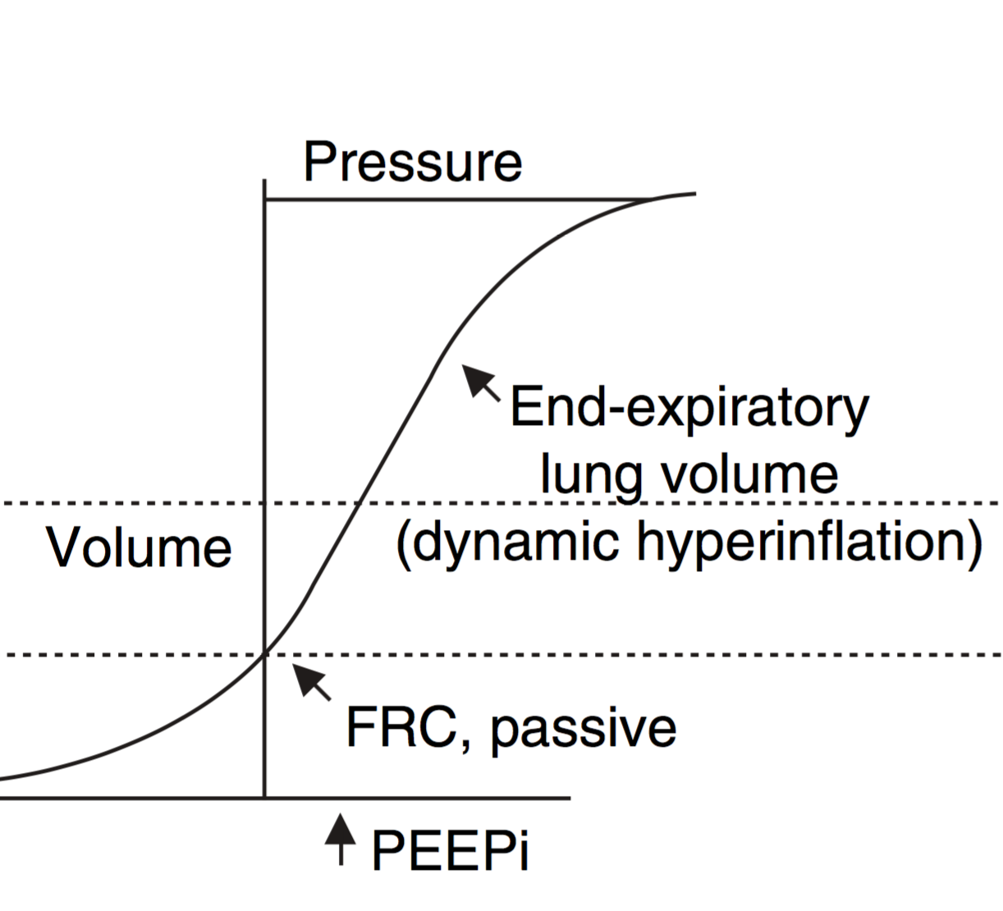
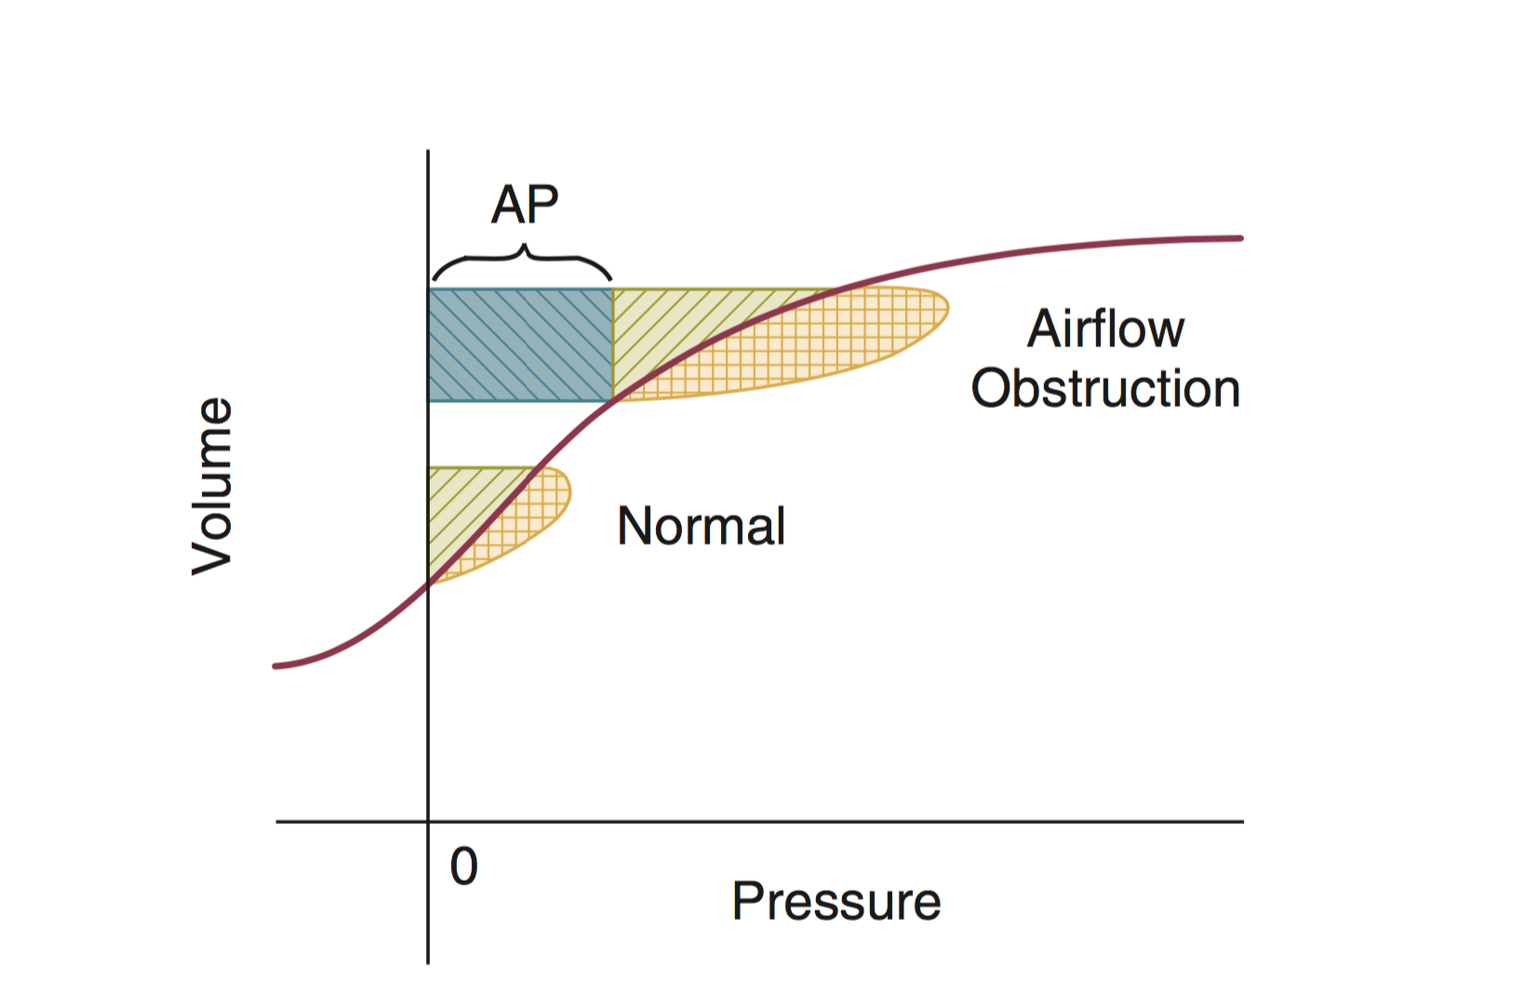
DYNAMIC HYPERINFLATION..
Shifts the “Tidal Breathing” to less compliant part of P-V curve ⫸ WOB
work to overcome auto-PEEP
Elstic work work
Resistive work
Increase in both elastic & resistive work

Slide 7
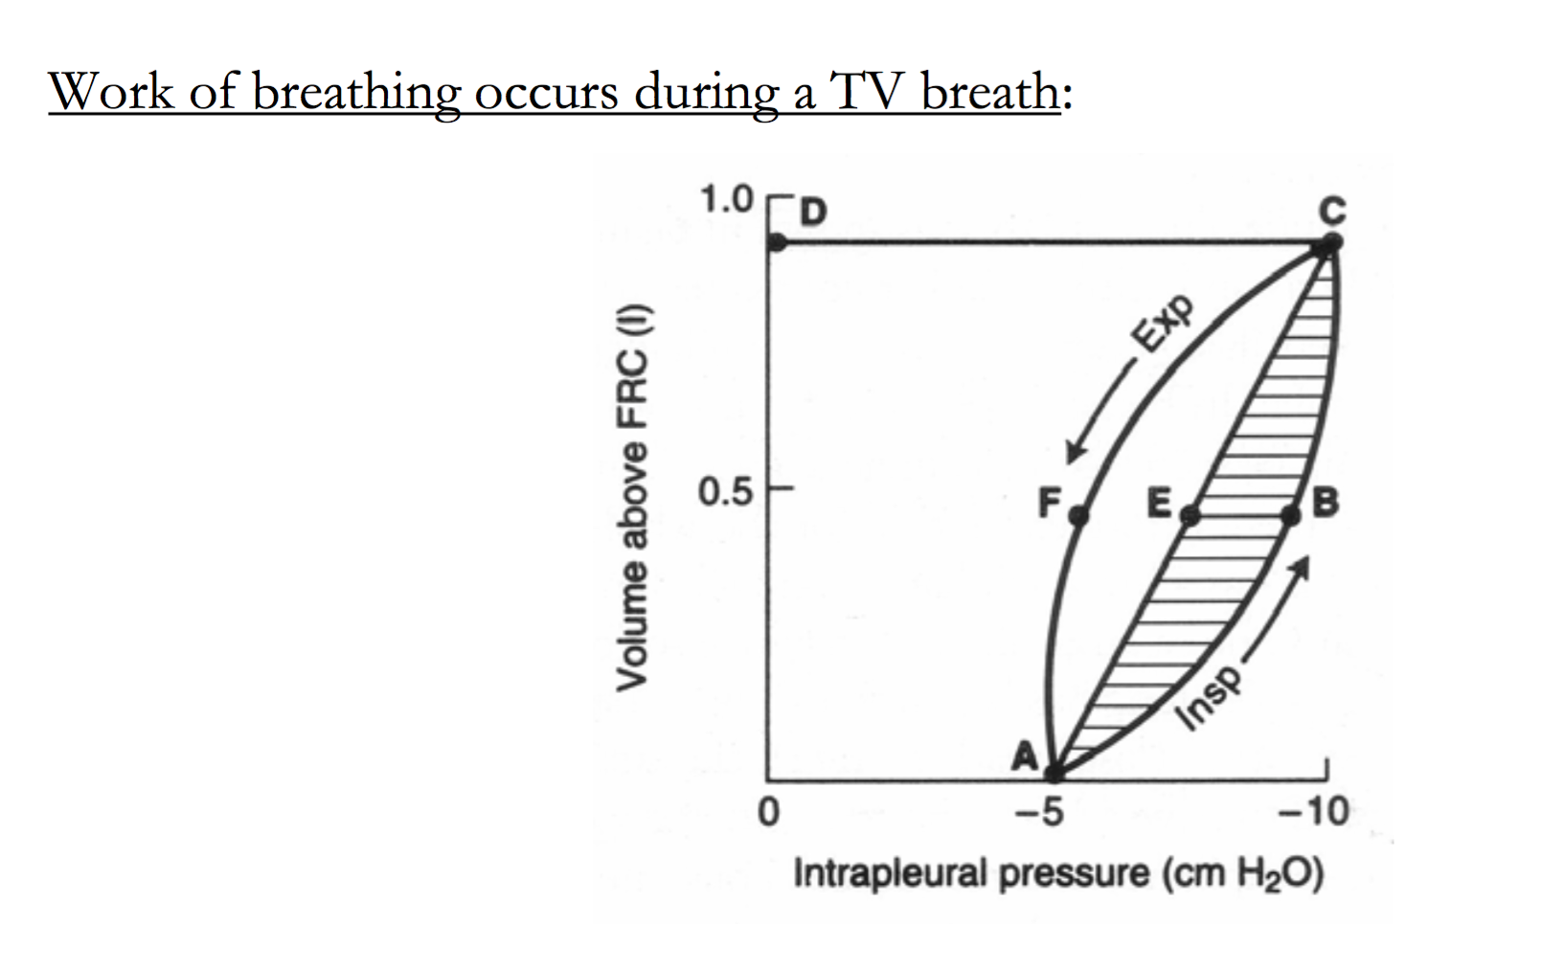
Increased Airway resistance
Increased Airway resistance⫸ ⇑ WOB

Slide 8
Increased lung volume
SPECIAL CHALLENGES
Increased lung volume- Increased WOB

Slide 9
Dynamic hyperinflation..
⇓ inspiratory flows- clinically observed as a ‘silent chest’.
It flattens the diaphragm and causes impaired diaphragmatic contraction.
⇓ Diaphragmatic blood supply.
Worsening of hypercapnic respiratory failure
Spyros A. Papiris Drugs 2009; 69 (17): 2363-2391.

Slide 10
Other systems..CVS
Expiration..
Significant decrease in venous return.
Inspiration..
Rapid increase in venous return➪ Rapid RV filling ➪ Left-ward shift of IVS
⇧ LV after load- Negative intra-thoracic pressure generated in inspiration increases LV after load
LV diastolic dysfunction & incomplete filling

Slide 11
On PA pressure
Raise PA pressure due to hyperinflation.
Pulsus paradoxus: significant reduction of the arterial systolic pressure in inspiration i.e >12mm Hg)

Slide 12
Identification and measurement of gas trapping

Slide 13
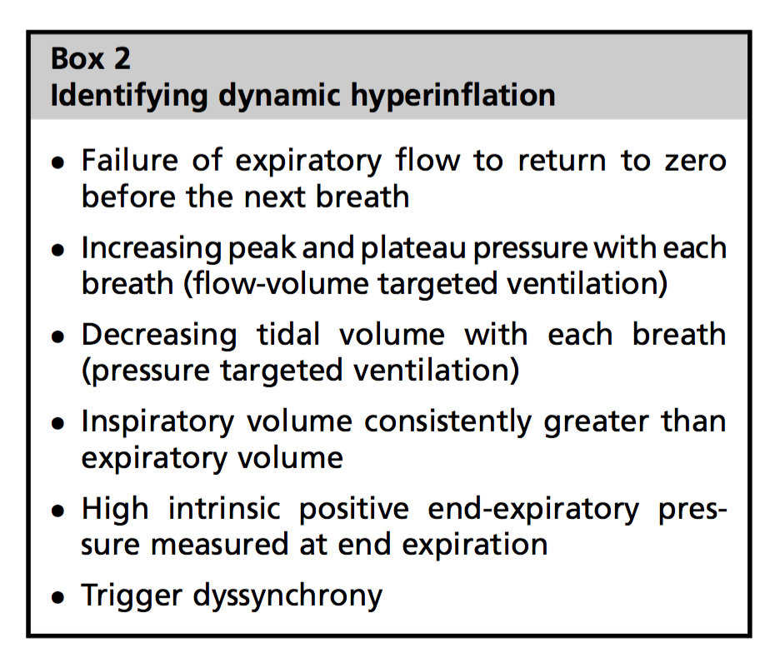
Identification and measurement of gas trapping
Stephen P. Bergin Clin Chest Med 37 (2016) 659–667

Slide 14
How to manage Auto-peep
Determinants of auto-PEEP
𝜶 Tidal volume
𝜶 Expiratory resistance
𝜶 1/compliance
𝜶 1/expiratory time

Slide 15
How to manage Auto-peep…. Interesting study
RESPIRATORY CARE • NOVEMBER 2004 VOL 49 NO 11

Slide 16
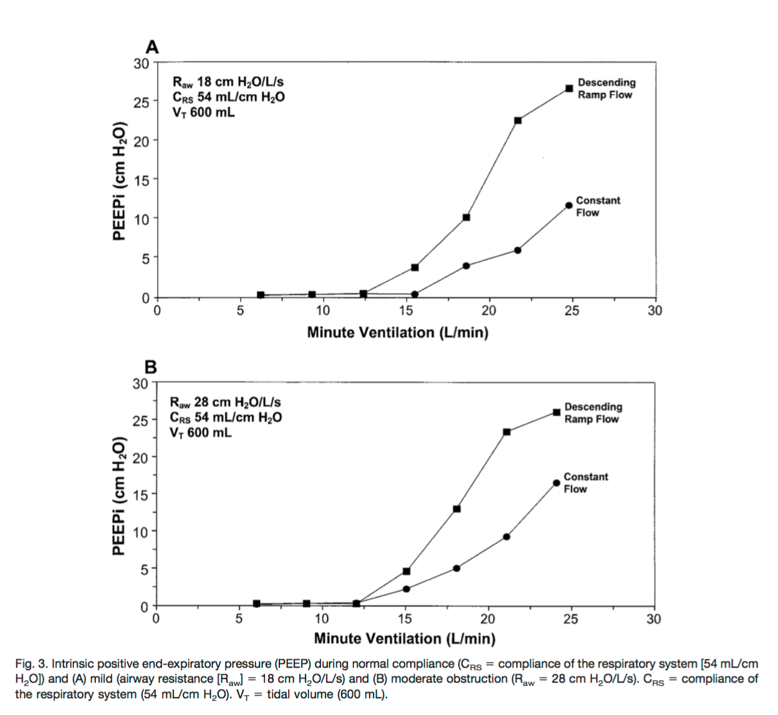
How to manage Auto-peep…. Interesting study
DHI:-
Higher iPEEP with higher airway resistance
RESPIRATORY CARE • NOVEMBER 2004 VOL 49 NO 11

Slide 17
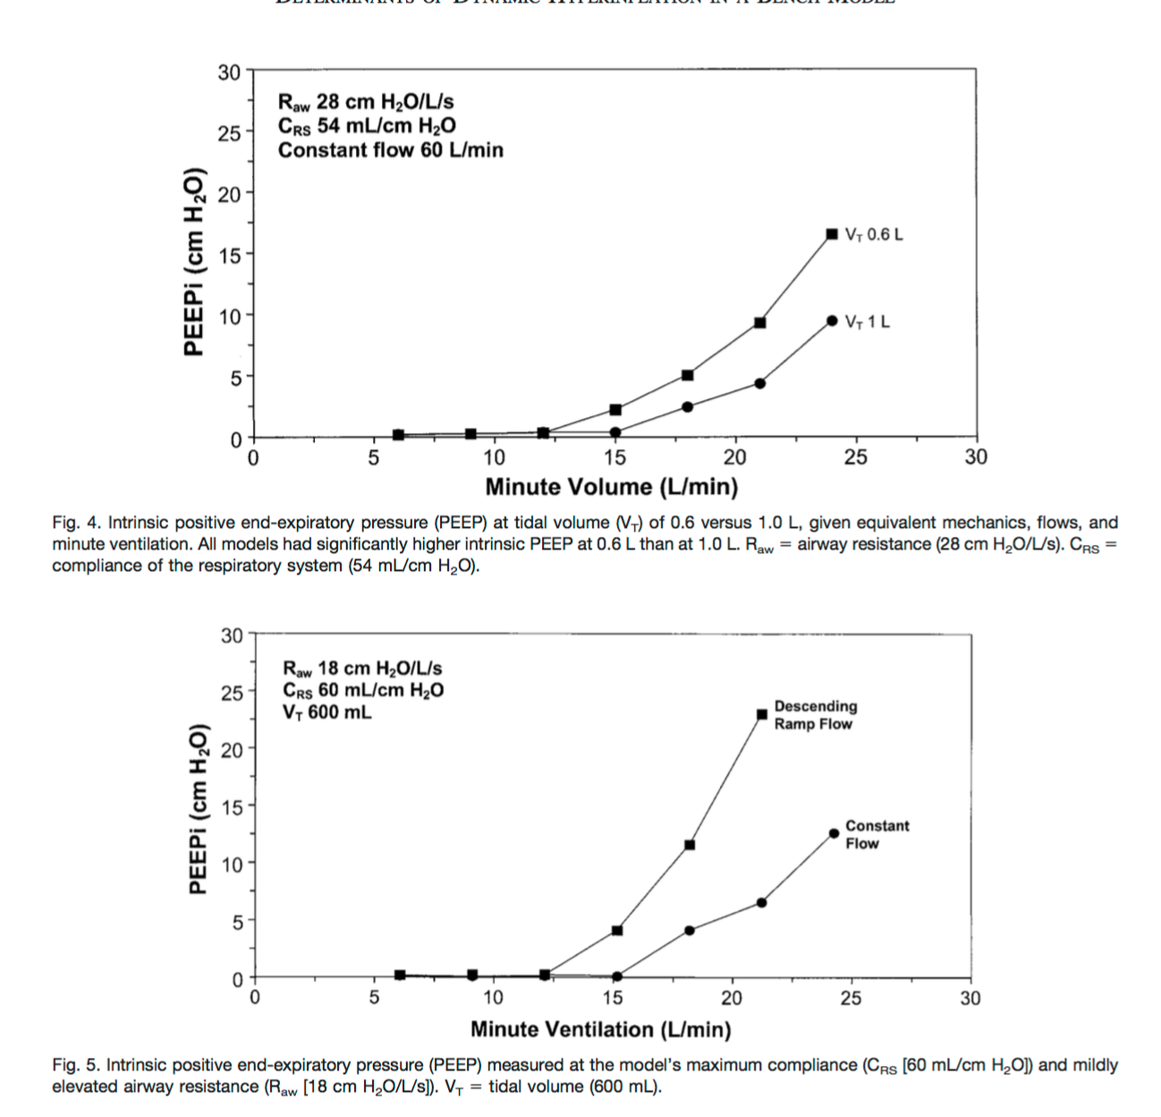
How to manage Auto-peep…. Interesting study
Minute ventilation- Critical determinant of DHI
DHI :-
RR is the major determinant
Higher tidal volume (1000ml Vs 600mL) has a lower iPEEP
Square wave pattern (Constant flow) developed a low iPEEP compared to decelerating flow.
RESPIRATORY CARE • NOVEMBER 2004 VOL 49 NO 11

Slide 18
Intubation.. consideration
Largest ETT
Anticipate hypotension due to
Sedation – loss of sympathetic drive
Dehydration- ⇮ WOB/RR, ⇩ venous return, overzealous ventilation
Sedation- Propofol/ Ketamine
Opioids- Fentanyl/Remifentanyl.. Morphine? Histamine release
NDMR- any except Atracurium

Slide 19
Ventilation.. Indications

Slide 20
Ventilation- Initial settings
Aim to allow permissive hypercapnia- pH>7.2 except- Cardiorespiratory arrest to prevent anoxic insult induced brain edema.¹
When inspiratory flow demands are high, variable inspiratory flow rates delivered by pressure-targeted ventilation may offer enhanced synchrony over flow- targeted volume-cycled modes.
1.Galluccio ST, Rai S, Sharley P. An unexpected ending: brain death following acute severe asthma. Crit Care Resusc 2008; 10: 235-8

Slide 21
Ventilation- Initial settings

Slide 22
Ventilation-modes
Volume Targeted
Near assured volume delivered
High airway pressures
High inspiratory flow rates and square inspiratory waveforms are better (on some ventilators)
Pressure Targeted
Better synchrony when inspiratory flow demands are higher
Consistent tidal volumes (VT) may be difficult to deliver

Slide 23
Ventilation- PIP
PIP –
Limit for Peak Inspiratory pressure(PIP) <50cm H₂O ¹
Highly dependent on inspiratory flow rate and airway resistance
Does not necessarily correlate with intrinsic positive end- expiratory pressures (PEEPi) or complications of barotrauma. ¹
Stephen P. Bergin. Clin Chest Med 37 (2016) 659–667

Slide 24
Ventilation- plateau PrEssure (P_{plat})
Pplat estimates of alveolar pressures
It may not accurately reflect the heterogeneous nature of hyperinflation associated with regional variations in airways obstruction.
Pplat of 30 cm H2O or less to prevent complications related to over distention and barotrauma. ^{1,2,3}
Brenner B. Intubation and mechanical ventilation of the asthmatic patient in respiratory failure. Proc Am Thorac Soc 2009;6(4):371–9.
Williams T. Risk factors for morbidity in mechanically ventilated pa- tients with acute severe asthma. Am Rev Respir Dis 1992;146(3):607–15.
Stephen P. Bergin. Clin Chest Med 37 (2016) 659–667

Slide 25
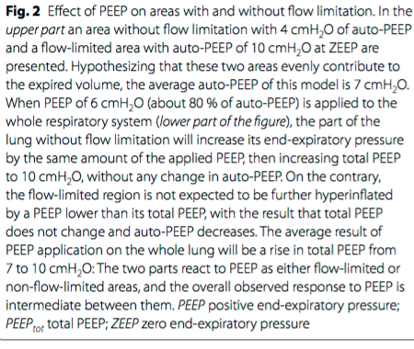
ePPEP for iPEEP- How does it work?

Slide 26
Expiratory flow limitations is the major determinant for diagnosis of PEEP absorbers.
Decreased respiratory rate is a key factor for limiting rise in total PEEP if extrinsic PEEP is applied

Slide 27
Ventilation-F_{i}O₂
Perrin etal. horax 66.11 (2011): 937-941.

Slide 28
Ventilation-F_{i}O₂
Perrin etal. horax 66.11 (2011): 937-941.

Slide 29
Ventilation-F_{i}O₂…less is better..
Loss of hypoxic pulmonary vasoconstriction
Halden’s effect- Deoxygenated Hb is a better carrier of CO2, Oxygenated Hb is poor carrier of CO2.

Slide 30
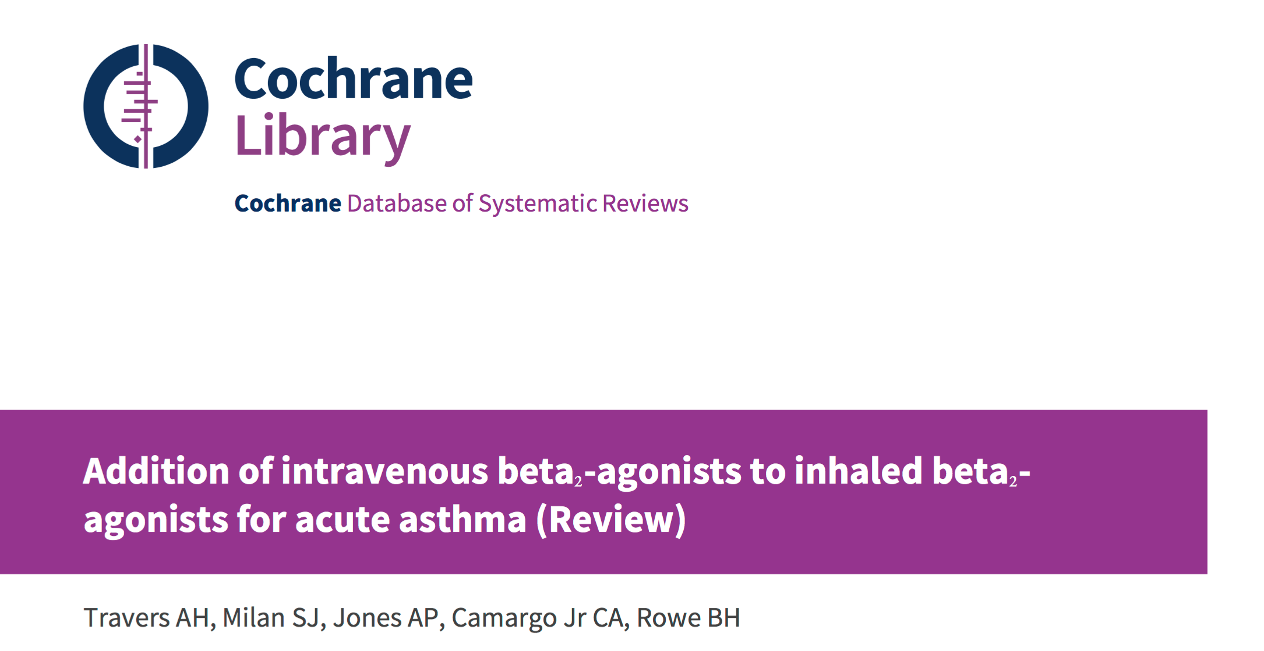
Drugs- bronchodilators(Beta-agonists)
No added benefit of IV or SC salbutamol in addition to nebulized salbutamol.1(lack of data rather than ineffective)
Travers 2012. Addition of intravenous beta(2)-agonists to inhaled beta(2)-agonists for acute asthma. Cochrane Database Syst Rev 12, CD010179

Slide 31
Drugs- bronchodilators(Beta-agonists
Include 15 studies with 746 patients in emergency department.

Slide 32
Drugs- bronchodilators(Beta-agonists
Dose:-5-10 mg of salbutamol – continuous nebulization preferred over intermittent nebs.

Slide 33
Drugs- bronchodilators(Beta-agonists + Anti-cholinergics)

Slide 34
Drugs- heliox
PEFR
CHEST 2003; 123:891–896

Slide 35
Drugs- heliox

Slide 36
Drugs- Magnesium
Intravenous administration of a single dose of magnesium sulfate (2 g infused over 20 min) is suggested for patients who have a life-threatening exacerbation

Slide 37
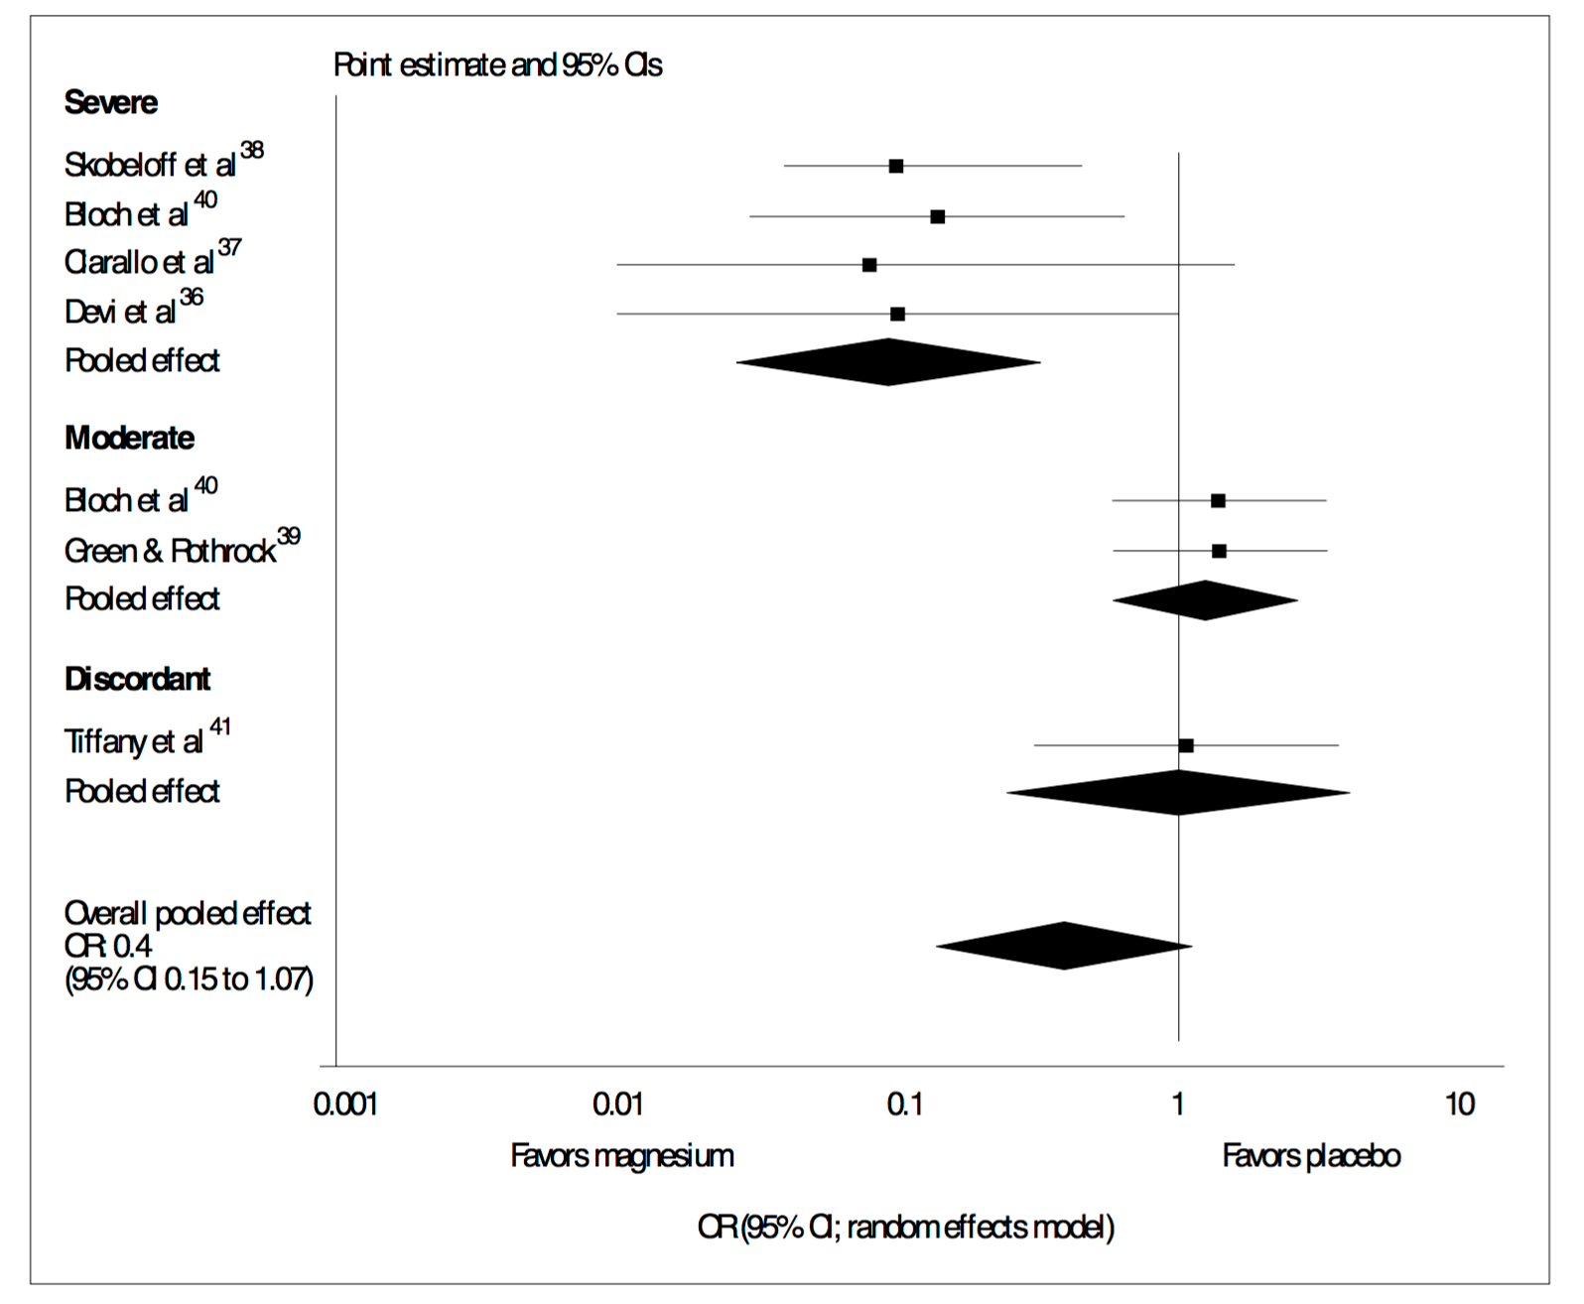
Drugs- Magnesium

Slide 38
Drugs- Magnesium

Slide 39
Drugs-corticosteroids
A higher initial dose of methylprednisolone 60 to 80 mg every 6 to 12 hours is often chosen for patients who are admitted to the intensive care unit.
Tapering oral glucocorticoids is not necessary if the duration of glucocorticoid treatment is less than three weeks.

Slide 40
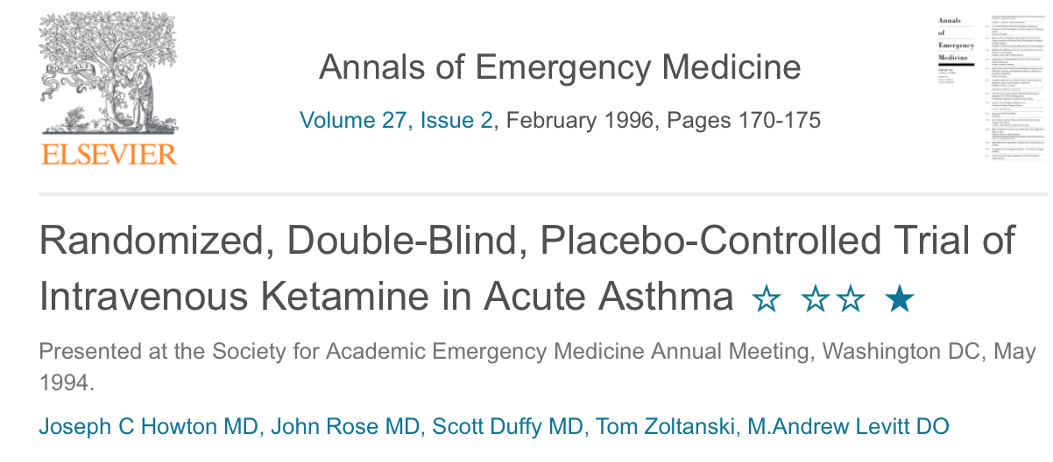
Drugs- propofol/ketamine
Case reports
0.1-2 mg/kg bolus f/b 0.5 to 2 mg/kg per hour (ketamine)

Slide 41
Drugs- inhaled gas
Experience is greatest with halothane for status asthmaticus
Isoflurane and Sevoflurane- case reports.
Dose titrated to the clinical response.
Hypotension is often the limiting factor.

Slide 42
Drugs-amminophylline
Relatively ineffective and is no longer recommended
Provide no further bronchodilation beyond that achieved with inhaled beta agonists alone when used in combination

Slide 43
Hypothermia for status-asthmaticus

Slide 44
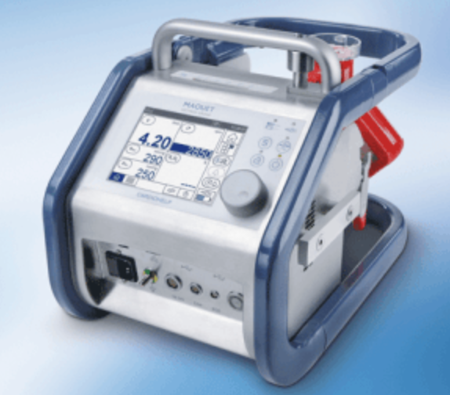
Ecmo

Slide 45
Moral of the story

